Slide 1
NVMe & MI
Eng.#3 SW Eng., James Hsiao
Revision 1.0
23 - June - 2020

Slide 2
Agenda
NVM Express™
Introduction
Theory & Architecture
Data Structures
Features
Directives
Changes in NVMe 1.4
NVM Express™ Management Interface
Introduction
Theory & Architecture
Message Transport
Message Servicing Model
Command Set
Examples
Denali Open-Channel SSDs
Introduction
Physical Page Address Command Set

Slide 3
NVM Express™
Introduction

Slide 4
What is NVMe™?
NVM Express™ (NVMe™) is a specification defining how host software communicates with non-volatile memory across a PCI Express® (PCIe®) bus. It is the industry standard for PCIe solid state drives (SSDs) in all form factors (U.2, M.2, AIC, EDSFF). NVM Express is the non-profit consortium of tech industry leaders defining, managing and marketing NVMe technology. In addition to the NVMe base specification, the organization hosts other specifications: NVMe over Fabrics (NVMe-oF™) for using NVMe commands over a networked fabric and NVMe Management Interface (NVMe-MI™) to manage NVMe/PCIe SSDs in servers and storage systems.
The NVMe specification was designed from the ground up for SSDs. It is a much more efficient interface, providing lower latency, and is more scalable for SSDs than legacy interfaces, like serial ATA (SATA). The first part of the specification is the host control interface. The NVMe architecture brings a new high performance queuing mechanism that supports 65,535 I/O queues each with 65,535 commands (referred to as queue depth, or number of outstanding commands). Queues are mapped to CPU cores delivering scalable performance. The NVMe interface significantly reduces the number of memory-mapped input/output commands and accommodates operating system device drivers running in interrupt or polling modes for higher performance and lower latency. The NVMe specification also contains host-to-device protocol for SSD commands used by an operating system for: read, write, flush, TRIM, firmware management, temperature, errors and others.
Notes:
From https://nvmexpress.org Home
Enterprise & Data Center SSD Form Factor (EDSFF): a stronger data center system-optimized design than traditional SSD form factors like M.2 or U.2. EDSFF has shown that it’s able to meet customer need for storage devices with its high density, capacity and performance. various use cases for E1.L, E1.S and E3.
SFF-TA-1001 (U.3): Common drive bay definition
• Specification ratified October 2017
• Defines a universal backplane definition for SAS, SATA, and NVMe drives
• Simplifies multi-protocol backplane design and lowers cost
• U.3 Drives backwards compatible to U.2 bays

Slide 5
NVM Express™ Technology Specification Roadmap
2015
2016
2017
2018
2019
2020
2021
Q1
Q2
Q3
Q4
Q1
Q2
Q3
Q4
Q1
Q2
Q3
Q4
Q1
Q2
Q3
Q4
Q1
Q2
Q3
Q4
Q1
Q2
Q3
Q4
Q1
Q2
Q3
Q4
NVMe 2.0*
NVMe Spec
NVMe 1.2.1 May’16
NVMe 1.3 May’17
NVMe 1.4 June’19
Sanitize
Streams
Virtualization
IO Determinism (NVM Sets)
Persistent Event Log, Rebuild Assist
Persistent Memory Region (PMR)
Asymmetric Namespace Access (ANA)
NVMe Base Spec
Merged w/Fabrics
Namespace Types
Alternate Cmd Sets
NVMe-oF 1.0 May’16
NVM-oF 1.1 Oct’19
NVMe Transport Spec(s)
NVMe-oF Spec
Transport and protocol
RDMA binding
Enhanced Discovery
TCP Transport Binding
NVMe Command Set Spec(s)
NVMe-MI 1.0 Nov’15
NVMe-MI 1.1 May’19
NVMe-MI Spec
Out-of-band management
Device discovery
Health & temp monitoring
Firmware Update
Enclosure Management
In-band Mechanism
Storage Device Extension
Released NVMe specification Planned release
Notes:
2021 NVMe 2.0 new structure of spec

Slide 6
NVMeTM spec family wasn’t structured for extensibility
NVMeTM Management Interface
NVMe Base
NVMe over Fabrics
Similar functions split between Base & Fabrics
PCIe ® transport integrated into Base
Command Sets not layered to enable extensibility
Queuing Model, Logs, Status Codes, Features, etc.
Discovery Service
NVM & Admin Command Sets
NVM-oF Command Set
Data Structures
Identify, Namespaces, SGLs, …
Data Structures
Capsules, Identify, SGLs, …
PCIe I/F
Transport Independent Definitions
Transport Specific Bindings (RDMA, TCP)
Need a new structure to enable innovation!

Slide 7
Optimizing the Specifications for Evolution
Transport Separation, Command Set Extensibility, Fabrics Base Integration
NVMe Management Interface Specification
Block IO
Key Value
Zoned Namespaces
TBD
Adds Fabrics concepts as core to NVMe
Eliminates duplication in data structures
Integration of NVMe and NVMe-oF base functions
Separate command set specs
Modular transport mapping layer, including PCIe
…
NVMeTM Base Specification
Current Base with removal of PCIe ® specifics
Integrate NVMe-oFTM content
Identify, SGLs, Capsules, Discovery, …
PCIe Transport Mapping
RDMA Transport Mapping
TCP Transport Mapping
TBD
…

Slide 8
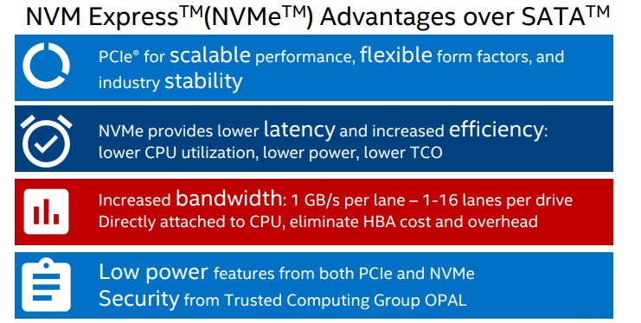
Why NVMe?
Notes:
Total cost of ownership (TCO)
Gen3: 1GB/s
Host Bus Adapter(HBA)
PCIE-Active State Power Management (ASPM): an autonomous hardware-based, active state mechanism that enablespower savings even when the connected components are in the D0 state.
NVMe: Autonomous Power State Transitions (APST)
The Opal “Family” of specifications published by the TCG provides a scalable infrastructure for managing encryption of user data in a Storage Device, as well as extensibility to enable features beyond “data at rest protection”.

Slide 9
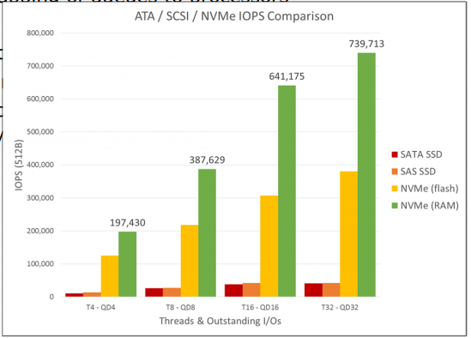
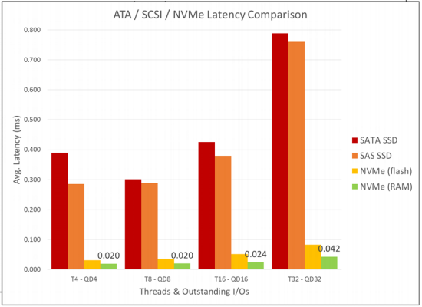
Why NVMe?
With great IOPs and low latency

Slide 10
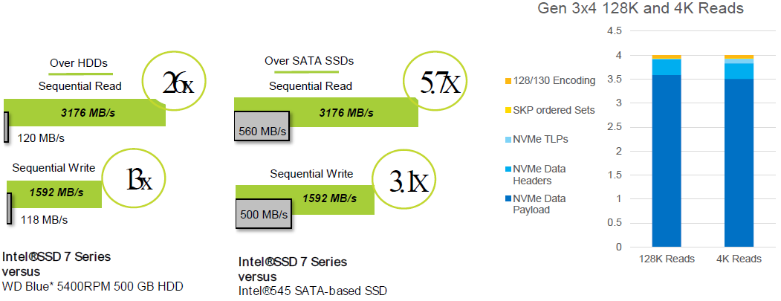
Why NVMe?
Removes the performance bottleneck
Notes:
Gen3 x 4: 4GB/s
Gen1 and Gen2, PCIe uses an 8b/10b transmission code. Gen3 or higher: 128b/130b encoding.
Overhead from 20% down to 2%

Slide 11
NVM Express™
Theory & Architecture

Slide 12
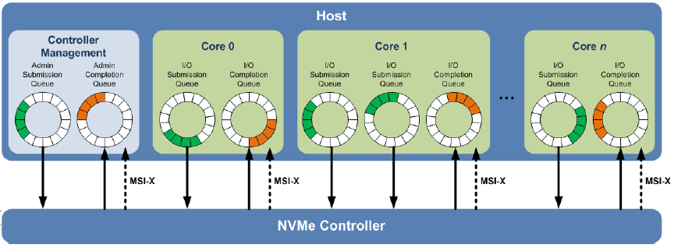
Theory of Operation
Technical Basics
Support for up to 65,535 I/O Queues, with each I/O Queue supporting up to 65,535 outstanding commands;
All information to complete a 4 KiB read request is included in the 64B command itself, ensuring efficient small I/O operation;
Efficient and streamlined command set (10 required Admin Commands, 3 required I/O Commands);
Support for MSI/MSI-X and interrupt aggregation;
Support for multiple namespaces, multi-path I/O and namespace sharing, and efficient support for I/O virtualization architectures like SR-IOV.
Notes:
Typical SAS devices support up to 256 cmds and SATA devices support up to 32 cmds in a single queue.
Register Reads per command: AHCI=4; NVMe = 0
Message Signaled Interrupts (MSI) is an optional feature that enables a device Function to request service by writing a system-specified data value to a system-specified address. System software initializes the message address and message data (“vector”) during device configuration, allocating one or more vectors to each MSI-capable Function.
Compared to MSI, MSI-X supports a larger max num 2Ki of vectors per Function, the ability for sw to ctrl aliasing when fewer vectors are allocated than requested, plus the ability for each vector to use an independent address and data value, specified by a table that resides in Memory Space.
MSI(訊息驅動中斷)是PCI Express 中定義的原生中斷產生方式。其方式是裝置為透過寫入一個特定的記憶體位址到根聯合體(Root Union)來觸發中斷。在使用MSI之前，Host 與Device必須先透過Configuration 設定協議好MSI 所對應的記憶體位址。
1) MSI: 定義於PCI 2.2的規範中，允許一個裝置能夠擁有1,2,4,8,16,32 個中斷向量
2) MSI-X:定義於PCI-3.0中，該規範允許裝置最多支援到2048個中斷向量。 原本的MSI使用單一位址的方式被發現在某些平台上有所限制。MSI-X允許為每一個中斷配置一個獨立的記憶體位址與訊息資料。
Single Root I/O Virtualization (SR-IOV)
NVMe supports 64K cmds per queue and up to 64K queues. These queues are designed such that I/O cmds and responses to those cmds operate on the same processor core and can take advantage of the parallel processing capabilities of multi-core processors. Each application or thread can have its own independent queue, so no I/O locking is required. NVMe also supports MSI-X and int. steering, which prevents bottlenecking at the CPU level and enables massive scalability as syss expand.
The NVMe is based on a paired SQ and CQ mechanism. Cmds are placed by host sw into a SQ. Completions are placed into the associated CQ by the ctrler. Multiple SQ may utilize the same CQ. SQ and CQ are allocated in mem.
An Admin SQ and associated CQ exist for the purpose of ctrler mngmnt and ctrl (e.g., creation and del of I/O SQ and CQ, aborting cmds, etc.). Only cmds that are part of the Admin Cmd Set may be submitted to the Admin SQ.
An I/O Cmd Set is used with an I/O queue pair. I/O Cmd Set named the NVM Cmd Set. The host selects one I/O Cmd Set that is used for all I/O queue pairs. Host sw creates queues, up to the max supported by the ctrler. Typically the number of cmd queues created is based on the sys config and anticipated workload. Core 0 - 1:1 mapping between SQ and CQ, Core 1 - multiple I/O SQ utilize the same I/O CQ, Admin SQ and CQ always a 1:1 mapping.

Slide 13
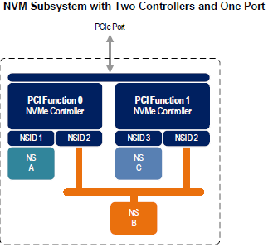
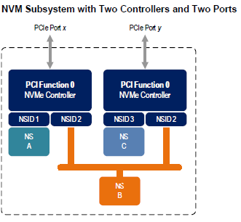
Theory of Operation
Multi-Path I/O and Namespace Sharing
An NVM subsystem includes one or more controllers, zero or more namespaces, and one or more ports. An NVM subsystem may include a non-volatile memory storage medium and an interface between the controller(s) in the NVM subsystem and non-volatile memory storage medium.
Multi-path I/O refers to two or more completely independent paths between a single host and a namespace while namespace sharing refers to the ability for two or more hosts to access a common shared namespace using different NVM Express controllers.
There is a unique Identify Controller data structure for each controller and a unique Identify Namespace data structure for each namespace. The same data structure contents are returned by all controllers with access to the same shared namespace. Controllers associated with a shared namespace may operate on the namespace concurrently.
Notes:
Both multi-path I/O and namespace sharing require that the NVM subsystem contain two or more controllers
NVM subsystem with two PCI Express ports, each with an associated controller. Both controllers map to PCI Function 0 of the corresponding port. Each PCI Express port in this example is completely independent and has its own PCI Express Fundamental Reset and reference clock input. A reset of a port only affects the controller associated with that port and has no impact on the other controller, shared namespace, or operations performed by the other controller on the shared namespace.

Slide 14
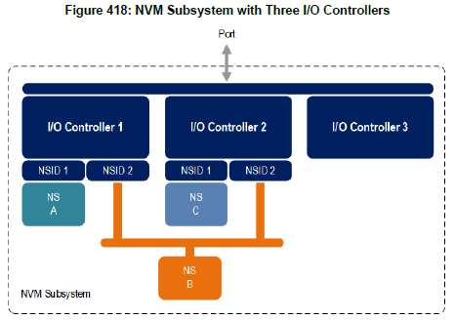
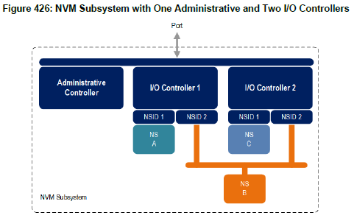
Controller Architecture
Controller Types
The Controller Type (CNTRLTYPE) field in the Identify Controller data structure indicates a controller’s type. Regardless of controller type, all controllers implement one Admin Submission Queue and one Admin Completion Queue. Depending on the controller type, a controller may also support one or more I/O Submission Queues and I/O Completion Queues.
I/O Controller: An I/O controller is a general purpose controller that supports commands that provide access to an NVM subsystem’s non-volatile storage medium and may support commands that provide management capabilities.
Administrative Controller: An administrative controller is a controller whose intended purpose is to provide NVM subsystem management capabilities. Unlike an I/O controller, an administrative controller does not support commands that provide access to logical block data and metadata stored on an NVM subsystem’s non-volatile storage medium.
Notes:
A controller is the interface between a host and an NVM subsystem
NVMe 1.4 defines an Administrative Controller as a controller that supports functionality intended to provide host management capabilities, such as the NVMe-MI in-band mechanism.
New controller type for Enclosure Management
Examples of management capabilities that may be supported by an administrative controller include the following.
• Ability to efficiently poll NVM subsystem health status via NVMe-MI using the NVMe-MI Send and NVMe-MI Receive commands;
• Ability to manage an NVMe enclosure via NVMe-MI using the NVMe-MI Send and NVMe-MI Receive commands;
• Ability to manage NVM subsystem namespaces using the Namespace Attachment and Namespace commands;
• Ability to perform virtualization management using the Virtualization Management command; and
• Ability to reset an entire NVM subsystem using the NVM Subsystem Reset (NSSR) register.

Slide 15
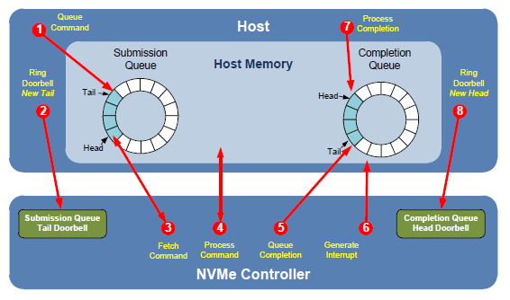
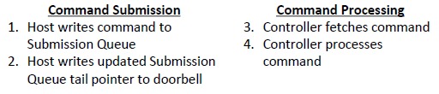
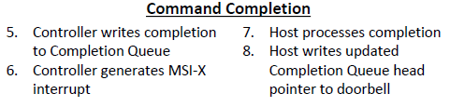
Controller Architecture
Command Submission and Completion Mechanism
Notes:
1. The host places one or more cmds for execution in the next free SQ slot(s) in memory;
2. The host updates the SQ Tail Doorbell register with the new value of the SQ Tail entry pointer. This indicates to the controller that a new cmd(s) is submitted for processing;
3. The controller transfers the cmd(s) from in the SQ slot(s) into the controller for future execution. Arbitration is the method used to determine the SQ from which the controller starts processing the next candidate cmd(s);
4. The controller then proceeds with execution of the next cmd(s). Cmds may complete out of order (the order submitted or started execution);
5. After a cmd has completed execution, the controller places a cq entry in the next free slot in the associated CQ. As part of the cq entry, the controller indicates the most recent SQ entry that has been consumed by advancing the SQ Head pointer in the completion entry. Each new cq entry has a Phase Tag inverted from the previous entry to indicate to the host that this cq entry is a new entry;
6. The controller optionally generates an interrupt to the host to indicate that there is a new cq entry to consume and process. This is shown as an MSI-X interrupt, a pin-based or MSI. Note that based on interrupt coalescing settings, an interrupt may or may not be generated for each new cq entry;
7. The host consumes and then processes the new cq entries in the CQ. This includes taking any actions based on error conditions indicated. The host continues consuming and processing cq entries until a previously consumed entry with a Phase Tag inverted from the value of the current cq entries is encountered; and
8. The host writes the CQ Head Doorbell register to indicate that the cq entry has been consumed. The host may consume many entries before updating the associated CQ Head Doorbell register.

Slide 16
Controller Architecture
Resets
NVM Subsystem Reset
Main power is applied to the NVM subsystem;
A value of 4E564D65h (“NVMe”) is written to the NSSR.NSSRC field;
Controller Level Reset
NVM Subsystem Reset;
Conventional Reset;
Function Level Reset; and
Controller Reset (i.e., CC.EN transitions from ‘1’ to ‘0’).
A Controller Level Reset consists of the following actions:
The controller stops processing any outstanding Admin or I/O commands;
All I/O Submission Queues are deleted;
All I/O Completion Queues are deleted;
The controller is brought to an Idle state. When this is complete, CSTS.RDY is cleared to ‘0’; and
All controller registers and internal controller state are reset.
To continue after a Controller Level Reset, the host shall:
Update register state as appropriate;
Set CC.EN to ‘1’;
Wait for CSTS.RDY to be set to ‘1’;
Configure the controller using Admin commands as needed;
Create I/O Completion Queues and I/O Submission Queues as needed; and
Proceed with normal I/O operations.
Notes:
Controller Registers: NVM Subsystem Reset.NVM Subsystem Reset Control
When an NVM Subsystem Reset occurs, the entire NVM subsystem is reset. This includes the initiation of a Controller Level Reset on all controllers that make up the NVM subsystem, disabling of the Persistent Memory Region associated with all controllers that make up the NVM subsystem, and a transition to the Detect LTSSM state by all PCI Express ports of the NVM subsystem.
There are three distinct types of Conventional Reset: cold, warm, and hot
The FLR mechanism enables software to quiesce and reset Endpoint hardware with Function-level granularity.
Controller Registers: Controller Configuration.Enable
Controller Registers: Controller Status.Ready

Slide 17
Controller Architecture
Queue Management
Queue Setup and Initialization
Configures the Admin Submission and Completion Queues by initializing the Admin Queue Attributes (AQA), Admin Submission Queue Base Address (ASQ), and Admin Completion Queue Base Address (ACQ) registers appropriately;
Configure the size of the I/O Submission Queues (CC.IOSQES) and I/O Completion Queues (CC.IOCQES);
Submits a Set Features command with the Number of Queues attribute set to the requested number of I/O Submission Queues and I/O Completion Queues. The completion queue entry for this Set Features command indicates the number of I/O Submission Queues and I/O Completion Queues allocated by the controller;
Determines the maximum number of entries supported per queue (CAP.MQES) and whether the queues are required to be physically contiguous (CAP.CQR);
Creates I/O Completion Queues within the limitations of the number allocated by the controller and the queue attributes supported (maximum entries and physically contiguous requirements) by using the Create I/O Completion Queue command; and
Creates I/O Submission Queues within the limitations of the number allocated by the controller and the queue attributes supported (maximum entries and physically contiguous requirements) by using the Create I/O Submission Queue command.
Notes:
Controller Registers: AQA.Admin Completion Queue Size
Controller Registers: AQA.Admin Submission Queue Size
The Queue Identifier for the Admin SQ and Admin CQ is 0h.
The Admin SQ and Admin CQ are required to be in physically contiguous memory.
ASQB & ACQB: the 52 most significant bits of the 64-bit physical address, shall be memory page aligned (based on the value in CC.MPS). The memory page size is (2 ^ (12 + MPS)). Thus, the minimum host memory page size is 4 KiB and the maximum host memory page size is 128 MiB.
CC.I/O Completion Queue Entry Size & CC. I/O Submission Queue Entry Size
NSQR & NCQR: Indicates the number requested by software.
NSQA & NCQA: Indicates the number allocated by the controller.
The value allocated may be smaller or larger than the number of queues requested, often in virtualized implementations. The controller may not have as many queues to allocate as are requested. Alternatively, the controller may have an allocation unit of queues (e.g., power of two) and may supply more queues to host software to satisfy its allocation unit.

Slide 18
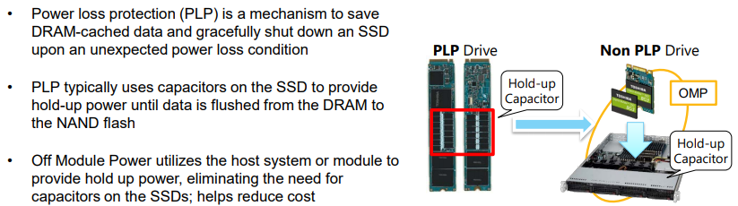
Controller Architecture
Shutdown
The host should perform the following actions in sequence for a normal shutdown:
Stop submitting any new I/O commands to the controller and allow any outstanding commands to complete;
If the controller implements I/O queues, then the host should delete all I/O Submission Queues, using the Delete I/O Submission Queue command. A result of the successful completion of the Delete I/O Submission Queue command is that any remaining commands outstanding are aborted;
If the controller implements I/O queues, then the host should delete all I/O Completion Queues, using the Delete I/O Completion Queue command; and
The host should set the Shutdown Notification (CC.SHN) field to 01b to indicate a normal shutdown operation. The controller indicates when shutdown processing is completed by updating the Shutdown Status (CSTS.SHST) field to 10b.
The host should perform the following actions in sequence for an abrupt shutdown:
Stop submitting any new I/O commands to the controller; and
The host should set the Shutdown Notification (CC.SHN) field to 10b to indicate an abrupt shutdown operation. The controller indicates when shutdown processing is completed by updating the Shutdown Status (CSTS.SHST) field to 10b.
Notes:
It is recommended that the host perform an orderly shutdown of the controller by following the procedure in this section when a power-off or shutdown condition is imminent.
Dell Inspiron 7390 System BIOS
- Supports the System Crash Protection (SCP) feature to protect NVMe devices.
Lenovo: PLP

Slide 19
NVM Express™
Data Structures

Slide 20
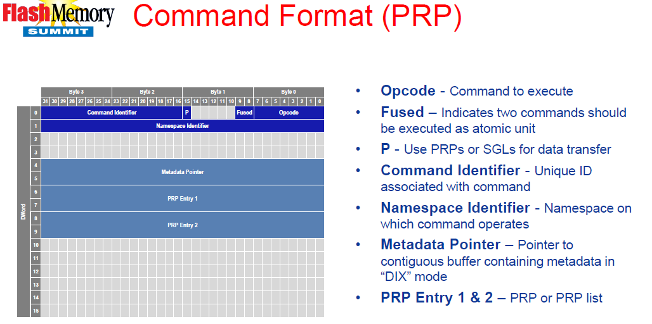
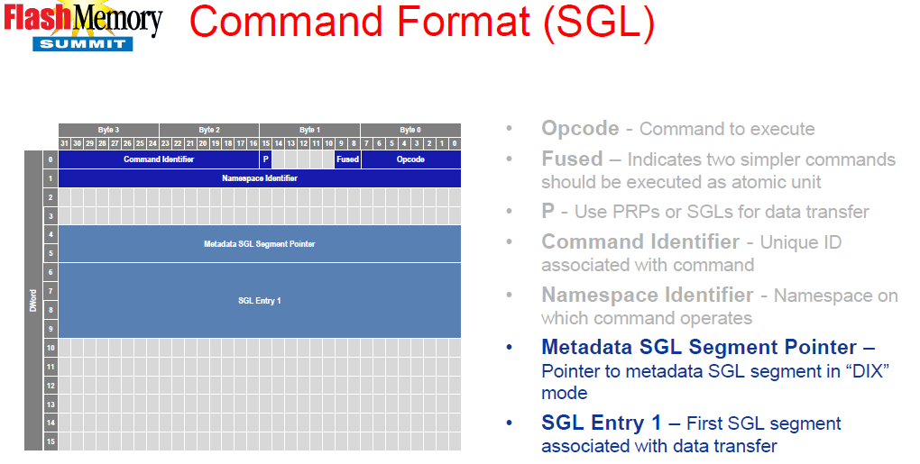
Data Structures
Submission Queue Entry
Each command is 64 bytes in size.
PRPs shall be used for all Admin commands for NVMe over PCIe implementations.
SGLs shall be used for all Admin and I/O commands for NVMe over Fabrics implementations.
Notes:
PRP or SGL for Data Transfer
SGLs shall not be used for Admin commands in NVMe over PCIe implementations.
FUSE: The commands shall be executed in sequence as an atomic unit. The operation ends at the point an error is encountered in either command. The LBA range, if used, shall be the same for the two commands. (Compare and Write)
(PSDT): This field specifies whether PRPs or SGLs are used for any data transfer associated with the command.
(PRP1): first PRP entry for the command or a PRP List pointer
(PRP2): Page Base Address of the second memory page or PRP List pointer if the data transfer crosses more than one memory page boundary.
Data Integrity Extension (DIX)

Slide 21
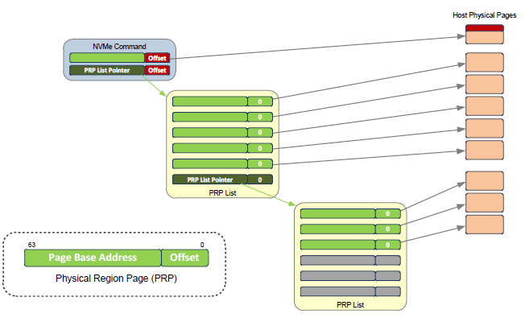
Data Structures
Physical Region Page Entry and List
A physical region page (PRP) entry is a pointer to a physical memory page. PRPs are used as a scatter/gather mechanism for data transfers between the controller and memory. A physical region page list (PRP List) is a set of PRP entries in a single page of contiguous memory.
Notes:
The size of the Offset field is determined by the physical memory page size configured in CC.MPS. (e.g., if the memory page size is 4 KiB, then bits 11:00 form the Offset)
the first PRP entry contained within the command may have a non-zero offset within the memory page. The first PRP List entry (i.e., the first pointer to a memory page containing additional PRP entries) that if present is typically contained in the PRP Entry 2 location within the command, shall be qword aligned and may also have a non-zero offset within the memory page.
PRP entries contained within a PRP List shall have a memory page offset of 0h.
If more PRP List pages are required, then the last entry of the PRP List contains the Page Base Address of the next PRP List page.

Slide 22
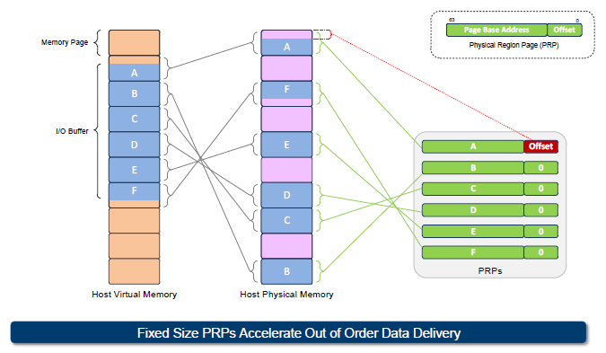
Data Structures
Physical Region Page Entry and List
To enable efficient out of order data transfers between the controller and the host, PRP entries are a fixed size.

Slide 23
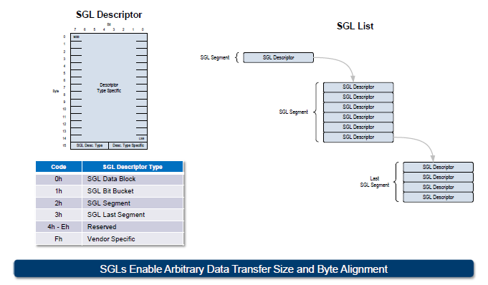
Data Structures
Scatter Gather List (SGL)
A Scatter Gather List (SGL) is a data structure in memory address space used to describe a data buffer. An SGL contains one or more SGL segments. An SGL segment is a qword aligned data structure in a contiguous region of physical memory describing all, part of, or none of a data buffer and the next SGL segment, if any. An SGL segment consists of an array of one or more SGL descriptors. Only the last descriptor in an SGL segment may be an SGL Segment descriptor or an SGL Last Segment descriptor.
Notes:
NVMe 1.1 adds additional optional client and Enterprise feature: Command Enhancements-SGL support
NVMe-oF only support SGL

Slide 24
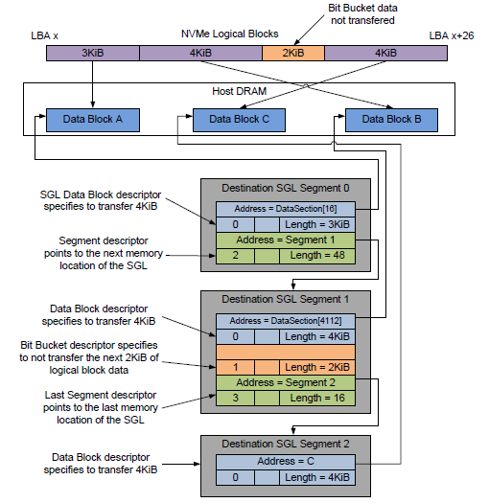
Data Structures
Scatter Gather List (SGL)
In the example, the logical block size is 512B. The total length of the logical blocks accessed is 13 KiB, of which only 11 KiB is transferred to the host. The Number of Logical Blocks (NLB) field in the command shall specify 26, indicating the total length of the logical blocks accessed on the controller is 13 KiB. There are three SGL segments describing the locations in memory where the logical block data is transferred.
The three SGL segments contain a total of three Data Block descriptors with lengths of 3 KiB, 4 KiB, and 4 KiB respectively. Segment 1 of the Destination SGL contains a Bit Bucket descriptor with a length of 2 KiB that specifies to not transfer (i.e., ignore) 2 KiB of logical block data from the NVM. Segment 1 of the destination SGL also contains a Last Segment descriptor specifying that the segment pointed to by the descriptor is the last SGL segment.
Notes:
(NLB)26=13 KiB/512B

Slide 25
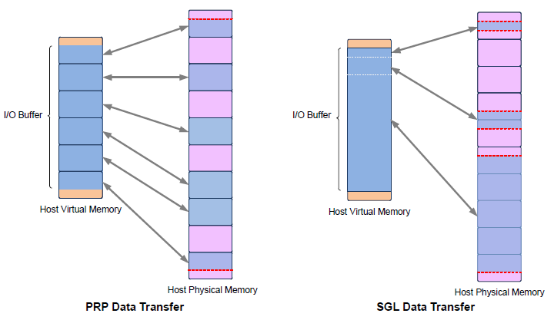
Data Structures
Comparing SGLs with PRPs
Notes:
NVMe 1.1 adds additional optional client and Enterprise feature: Command Enhancements-SGL support
NVMe-PCIe: Admin only PRP; I/O both PRP or SGL
NVMe-oF only support SGL
PRP: client, SGL: ED
SOC support
SGL Support (SGLS) field of the Identify Controller data structure

Slide 26
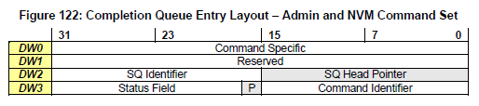
Data Structures
Completion Queue Entry
An entry in the Completion Queue is at least 16 bytes in size.
Status Field
Indicates status for the command that is being completed. A value of 0h for the Status Field indicates a successful command completion, with no fatal or non-fatal error conditions.
Status Code Type (SCT)
0h: Generic Command Status
1h: Command Specific Status
2h: Media and Data Integrity Errors
3h: Path Related Status
Status Code (SC)
00h to 7Fh: Applicable to Admin Command Set, or across multiple command sets;
80h to BFh: I/O Command Set Specific status codes; and
C0h to FFh: Vendor Specific status codes.
Notes:
SQ Identifier (SQID): Indicates the SQ to which the associated cmd was issued. This field is used by host sw when more than one SQ shares a single CQ to uniquely determine the cmd completed in combination with the Cmd Identifier (CID).
SQ Head Pointer (SQHD): Indicates the current SQ Head pointer for the SQ indicated in the SQ Identifier field. This is used to indicate to the host the SQ entries that have been consumed and may be re-used for new entries.
Phase Tag (P): Identifies whether a CQ entry is new.
Command Identifier (CID): Indicates the identifier of the cmd that is being completed. This identifier is assigned by host sw when the cmd is submitted to the SQ. The combination of the SQ Identifier and CID uniquely identifies the cmd that is being completed. The maximum number of requests outstanding for a SQ at one time is 64 Ki.

Slide 27
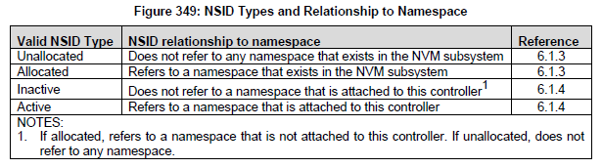
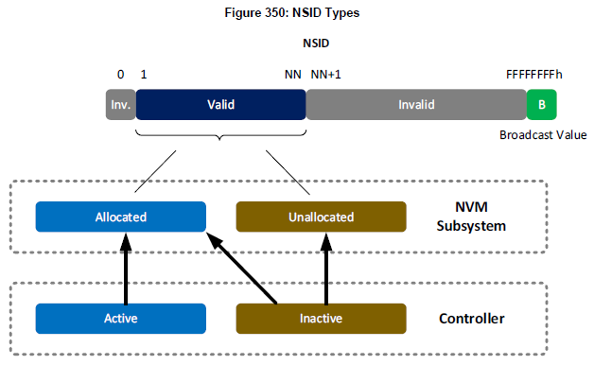
Data Structures
Namespaces
A namespace is a collection of logical blocks whose logical block addresses range from 0 to the size of the namespace – 1. A namespace ID (NSID) is an identifier used by a controller to provide access to a namespace.
Any NSID is valid, except if that NSID is 0h or greater than the Number of Namespaces field reported in the Identify Controller data structure. NSID FFFFFFFFh is a broadcast value that is used to specify all namespaces.
Notes:
For NVM subsystem:
Allocated NSIDs refer to namespaces that exist in the NVM subsystem. Unallocated NSIDs do not refer to any namespaces that exist in the NVM subsystem.
For controller:
Active NSIDs refer to namespaces that are attached to that controller. Allocated NSIDs that are inactive refer to namespaces that are not attached to that controller.
Unallocated NSIDs are inactive NSIDs for all controllers in the NVM subsystem.
An allocated NSID may be an active NSID for some controllers and an inactive NSID for other controllers in the same NVM subsystem if the namespace that the NSID refers to is attached to some controllers, but not all controllers, in the NVM subsystem.
The Namespace Management command is used to create a namespace or delete a namespace. The Namespace Attachment command is used to attach and detach controllers from a namespace.

Slide 28
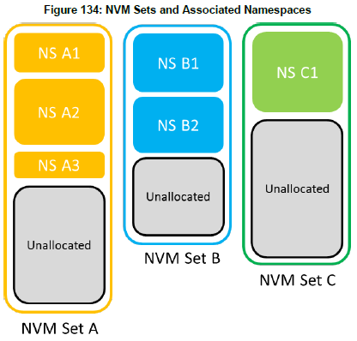
Data Structures
NVM Sets
An NVM Set is a collection of NVM that is separate (logically and potentially physically) from NVM in other NVM Sets. One or more namespaces may be created within an NVM Set and those namespaces inherit the attributes of the NVM Set. A namespace is wholly contained within a single NVM Set and shall not span more than one NVM Set.
For each NVM Set, the attributes include:
an identifier associated with the NVM Set;
the optimal size for writes to the NVM Set;
the total capacity of the NVM Set; and
the unallocated capacity for the NVM Set.
Notes:
Figure 133 shows an example of three NVM Sets. NVM Set A contains three namespaces (NS A1, NS A2, and NS A3). NVM Set B contains two namespaces (NS B1 and NS B2). NVM Set C contains one namespace (NS C1). Each NVM Set shown also contains ‘Unallocated’ regions that consist of NVM that is not yet allocated to a namespace.
The host determines the NVM Sets present and their attributes using the Identify command with CNS value of 04h to retrieve the NVM Set List

Slide 29
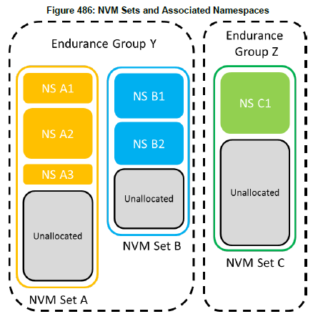
Data Structures
Endurance Groups
Endurance may be managed within a single NVM Set or across a collection of NVM Sets. Each NVM Set is associated with an Endurance Group. If two or more NVM Sets have the same Endurance Group Identifier, then endurance is managed by the NVM subsystem across that collection of NVM Sets.
If Endurance Groups are supported, then the NVM subsystem and all controllers shall:
Indicate support for Endurance Groups in the Controller Attributes field in the Identify Controller data structure;
Indicate the Endurance Group Identifier with which the namespace is associated in the Identify Namespace data structure; and
Support the Endurance Group Information log page.
Notes:
Figure 484 shows Endurance Groups added to the example in Figure 133. In this example, the endurance of NVM Set A and NVM Set B are managed together as part of Endurance Group Y, while the endurance of NVM Set C is managed only within NVM Set C which is the only NVM Set that is part of Endurance Group Z.
The endurance information for an Endurance Group is specified in the Endurance Group Information log page

Slide 30
Data Structures
Persistent Memory Region (PMR)
PCIe memory space on the SSD exposed to the Host
May be used to store command data
Contents persist across power cycles, resets and disabling of the PMR
Usage Models for PMR
Logs for SW RAID, EC & Databases
Journals for File Systems
Metadata
Staging area for data pre-processing
Network transactions
Notes:
Controller Registers: PMRCAP, PMRCTL, PMRSTS,
PMREBS(PMR Elasticity Buffer Size),
PMRSWTP(Sustained Write Throughput),
PMRMSC(Controller Memory Space Control)
When command data and metadata transfers to or from PMR are supported, all data and metadata associated with a particular command shall be either entirely located in the Persistent Memory Region or outside the Persistent Memory Region.

Slide 31
NVM Express™
Features

Slide 32
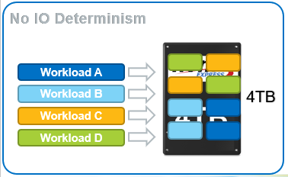
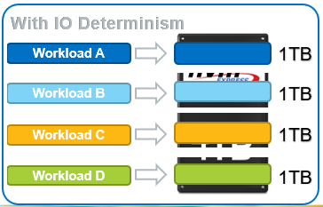
Features
IO Determinism – NVM Sets
NVM Sets are QoS Isolated
Write to namespace A1 does not impact QoS associated with namespace B2
NVM Subsystem may support one or more NVM Sets
One or more Namespaces may be allocated to an NVM Set
IO Determinism & NVM Sets work together to provide improved QoS!
Notes:
Service isolation region
Increase Read IOPs and reduce tail latency
Provides strict QoS profile

Slide 33
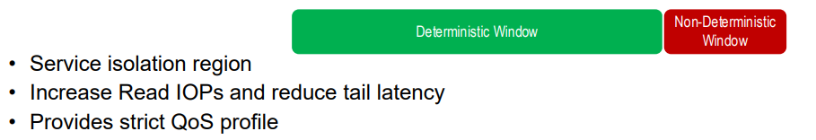
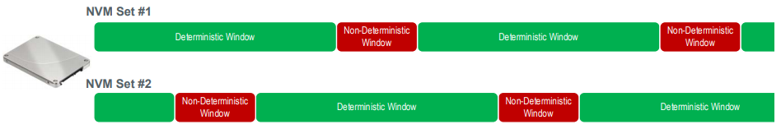
Features
IO Determinism – Predictable Latency Mode
Predictable Latency Mode is used to achieve predictable latency for read and write operations. When configured to operate in this mode using the Predictable Latency Mode Config Feature, the namespaces in an NVM Set provide windows of operation for deterministic operation or non-deterministic operation.
When Predictable Latency Mode is enabled:
NVM Sets and their associated namespaces have vendor specific quality of service attributes;
I/O commands that access NVM in the same NVM Set have the same quality of service attributes; and
I/O commands that access NVM in one NVM Set do not impact the quality of service of I/O commands that access NVM in a different NVM Set.
Notes:
To remain in the Deterministic Window, the host is required to follow operating rules ensuring that certain attributes do not exceed the typical or maximum values indicated in the Predictable Latency Per NVM Set log page.
Log Page Support: Predictable Latency Per NVM Set, Predictable Latency Event Aggregate
Feature Support: Predictable Latency Mode Config, Predictable Latency Mode Window

Slide 34
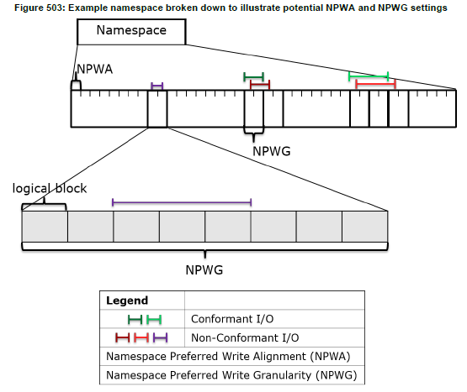
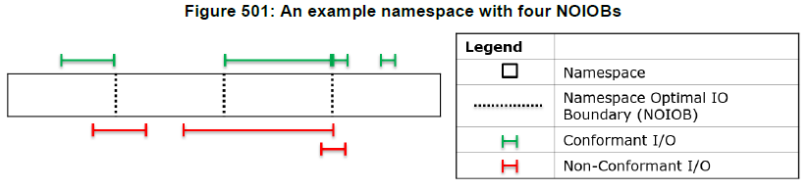
Features
IO Performance and Endurance Hints
Defines performance and endurance hints enabling the controller to indicate granularities and alignments that are preferred for Write and Deallocate operations.
Notes:
Improving Performance through I/O Size and Alignment Adherence
Each Write, Write Uncorrectable, or Write Zeroes cmds should address a multiple of NPWG and Stream Write Size (SWS) logical blocks (as expressed in the NLB field), and the SLBA field of the cmd should be aligned to NPWA for best performance.
an example namespace is diagrammed with three NOIOB. The NOIOB attribute should be applied to Read, Compare, Verify, Write, Write Uncorrectable, and Write Zeroes I/O cmds. The four green lines are example I/O cmds from the host that adhere to the recommendations of NOIOB settings for this namespace. None of the four I/O cmds shown in green cross an NOIOB. The three I/O cmds shown in red violate the recommendations for improved performance. The longest I/O cmd shown in red crosses one NOIOB and ends aligned with a different NOIOB. The remaining two I/O cmds shown in red also cross an NOIOB. All three of these example I/O cmds shown in red could be split into two I/O cmds that adhere to the recommendations provided by the namespace for NOIOB.
Each range in a Dataset Management cmd with the Attribute - Deallocate (AD) bit set to ‘1’ should contain a multiple of NPDG logical blocks and the start of each range should be aligned to NPDA and Stream Granularity Size (SGS) logical blocks.
Identify Namespace Data Structure

Slide 35
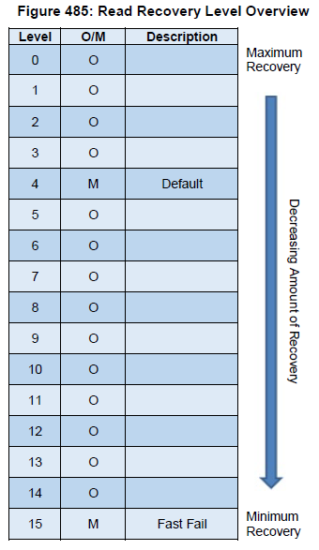
Features
Read Recovery Level
The Read Recovery Level (RRL) is a NVM Set configurable attribute that balances the completion time for read commands and the amount of error recovery applied to those read commands.
Notes:
Read Recovery Levels Supported field in the Identify Controller data structure
A namespace created within an NVM Set inherits the Read Recovery Level of that NVM Set.

Slide 36
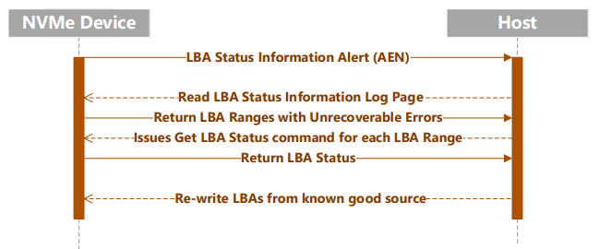
Features
Rebuild Assist
Host is able to configure NVMe™ Device for notifications about potentially unrecoverable LBAs. This may be used to determine what LBAs on a device should be recovered by the host from another location and re-written.
Establishes mechanism for early communication of two types of errors:
‘Tracked LBA’ list – LBAs discovered to now be bad by Device through a background scan.
‘Untracked LBA’ list – LBA ranges associated with a component failure by a scan originated by a Get LBA Status command.
Notes:
Potentially Unrecoverable LBAs are LBAs that, when read, may result in the cmd that caused the media to be read being aborted with Unrecovered Read Error status.
Defines a new Get LBA Status capability that identifies the potentially unrecoverable LBAs to the host. This status may be used to determine what LBAs on a device should be recovered by the host from another location and re-written.
The Tracked LBA list is able to be returned without significant delay; Untracked LBAs list significant delays may be incurred during the processing. After discovery of Untracked LBAs, they may or may not be added to the list of Tracked LBAs.

Slide 37

Features
Verify Command
New Command to check the integrity of stored data and metadata.
Effectively acts as Read without transferring any data or metadata to the Host
Controller reads & discards the data – while performing equivalent Protection Information checks
Errors are generated if data cannot be read correctly
Notes:
Adds a Verify command to check the integrity of stored data and metadata. The Verify command is roughly equivalent to a Read command that discards the data and metadata after reading. The important behavior of Verify is that errors are reported if the data or metadata cannot be read without expending the time and resources required to return the data and metadata to the host.

Slide 38
Features
Persistent Event Log
The Persistent Event Log page contains information about significant events not specific to a particular command. The information in this log page shall be retained across power cycles and resets. This log page is global to the NVM subsystem.
The Persistent Event Log defines the features necessary to build a scaffolding that enables extensible debug infrastructure that is usable at scale.
Comprehensive set of events defined
Health Snapshot
Firmware Commits
Timestamp Changes
Power-on or Resets
Thermal Excursions
Vendor Specific
TCG-defined Events
Hardware Errors
Changed Namespace
Set Feature Events
Format NVM Start & Complete
Sanitize Start & Complete
Allows SSD customers to get consistent debug capabilities across vendors!
Allows SSD vendors an extensible framework for custom debug content!
Notes:
Defines a mechanism for a persistent event log in NVMe subsystems. The log is intended to persistently capture significant events for use by software/system vendors that are not the NVMe subsystem manufacturer.

Slide 39
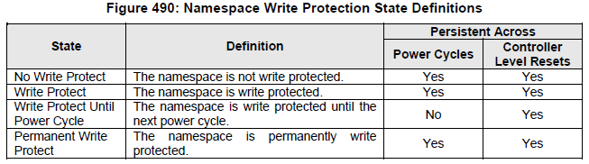
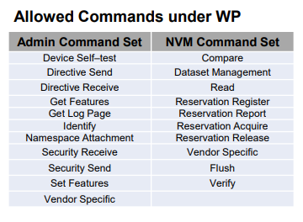
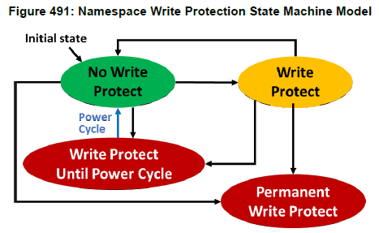
Features
Namespace Write Protection
Namespace Write Protection is an optional configurable controller capability that enables the host to control the write protection state of a namespace or to determine the write protection state of a namespace.
Notes:
Defines enhancement that controls write protection on a per namespace basis. This feature may be used to prevent modification of the specified namespace.
All state transitions are based on Set Features commands
The Write Protect Until Power Cycle and Permanent Write Protect states are subject to the Namespace Write Protection Authentication Control mechanism, which determines whether the controller processes or aborts Set Features commands which cause a transition into either of these two states(8.10 Replay Protected Memory Block)
The Replay Protected Memory Block (RPMB) provides a means for the system to store data to a specific memory area in an authenticated and replay protected manner. This is provided by first programming authentication key information to the controller that is used as a shared secret.

Slide 40
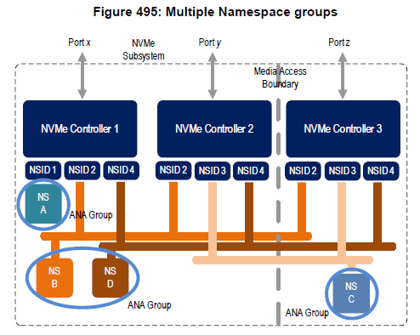
Features
Asymmetric Namespace Access Reporting
ANA occurs in environments where namespace access characteristics may vary based on the controller used to access the namespace and the internal configuration of the NVM subsystem. ANA Reporting is used to indicate to the host information about those access characteristics.
While commands may be sent to a shared namespace through any attached controller with asymmetric access, the characteristics may differ based on which controller is used; as a result, the host should consider those characteristics when selecting which controller to use for each command that accesses the namespace.
Notes:
Multi-Path I/O and Namespace Sharing
access characteristics (e.g., performance or ability to access the media)
of which the namespace is a member. Each namespace that is attached to a controller that support
The ANA Group maintains the same asymmetric namespace access state for all namespaces that are members of that ANA Group
Identify Controller Data Structure:
Asymmetric Namespace Access Capabilities (ANACAP): This field indicates the capabilities associated with Asymmetric Namespace Access Reporting.
Identify Namespace Data Structure:
ANA Group Identifier (ANAGRPID): This field indicates the ANA Group Identifier of the ANA group (refer to section 8.20.2) s Asymmetric Namespace Access Reporting (refer to the CMIC field) shall report a valid ANAGRPID.

Slide 41
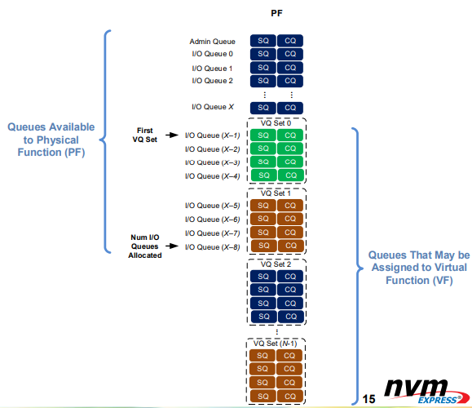
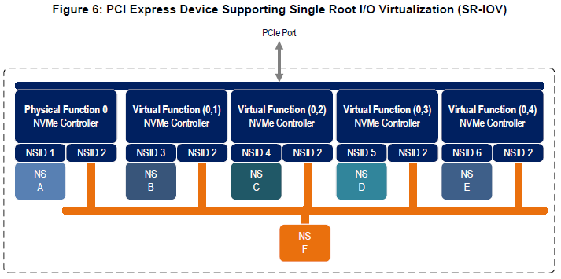
Features
Virtualization Enhancements
The NVMe model has primary controllers (which may be SR-IOV Physical Functions) and secondary controllers (which may be SR-IOV Virtual Functions) that may be used to flexible assign resources, like queues, from a primary controller to a secondary controller.
Controller resources may be assigned or removed from a controller using the Virtualization Management command issued to a primary controller. The following types of controller resources are defined:
• Virtual Queue Resource (VQ Resource): a type of controller resource
that manages one SQ and one Completion Queue (CQ)
• Virtual Interrupt Resource (VI Resource): a type of controller resource
that manages one interrupt vector.
Notes:
Figure 6 illustrates an NVM subsystem that supports Single Root I/O Virtualization (SR-IOV) and has one Physical Function and four Virtual Functions. An NVM Express controller is associated with each Function with each controller having a private namespace and access to a namespace shared by all controllers, labeled NS F. The behavior of the controllers in this example parallels that of the other examples in this section.
• Resources may be moved between the PF and VF(s)
• VQ Set – A set of (four) Submission Queue (SQ) and Completion Queue (CQ) pairs that may be assigned to a VF
• VI Set – A set of (four) MSI-X interrupt resources that may be assigned to a VF
Flexible Resources are controller resources that may be assigned to the primary controller or one of its secondary controllers.
Private Resources are controller resources that are permanently assigned to a primary or secondary controller. These resources are not supported by the Virtualization Management command.
Virtualization Management command is used for several functions:
• Modifying Flexible Resource allocation for the primary controller;
• Assigning Flexible Resources for secondary controllers; and
• Setting the Online and Offline state for secondary controllers.
The primary controller is allowed to have a mix of Private and Flexible Resources for a particular controller resource type. If there is a mix, then the Private Resources occupy the lower contiguous range of resource identifiers starting with 0. Secondary controllers shall have all Private or all Flexible Resources for a particular resource type. Controller resources assigned to a secondary controller always occupy a contiguous range of identifiers with no gaps, starting with 0. If a particular controller resource type is supported as indicated in the Controller Resource Types field of the Primary Controller Capabilities Structure, then all secondary controllers shall have that controller resource type assigned as a Flexible Resource. Figure 459 shows the controller resource allocation model for a controller resource type that is assignable as a Flexible Resource.

Slide 42
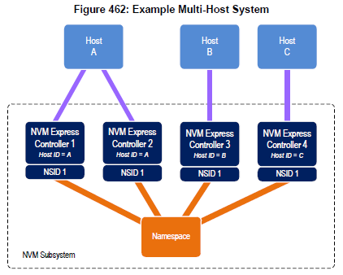
Features
Reservations
Reservations provide capabilities that may be utilized by two or more hosts to coordinate access to a shared namespace.
A reservation on a namespace restricts hosts access to that namespace. If a host submits a command to a namespace in the presence of a reservation and lacks sufficient rights, then the command is aborted by the controller with a status of Reservation Conflict.
•Example: Host A and B have read/write access and host C has read-only access to the shared namespace
HostA-Register(NSID,Key_A) -> OK
HostB-Register(NSID,Key_B) -> OK
HostA-AcquireReservation(NSID, Reservation, WriteExclusiveRegistrantsOnly,Key_A) -> OK
HostB-AcquireReservation(NSID, Reservation, WriteExclusiveRegistrantsOnly,Key_B) -> OK
HostC-AcquireReservation(NSID, Reservation, WriteExclusiveRegistrantsOnly,Key_C) -> Error – Reservation Conflict
…
HostA-Read(NSID) -> OK
HostA-Write(NSID) -> OK
…
HostB-Read(NSID) -> OK
HostB-Write(NSID) -> OK
…
HostC->Read(NSID) -> OK
HostC->Write(NSID) -> Error – Reservation Conflict
…
HostA-ReleaseReservation(NSID, Key_A) -> OK
HostC-Write(NSID) -> OK
…
Notes:
When a command to clear a reservation is executed the following occur as an atomic operation: the reservation held on the namespace, if any, is released, and all registrants are unregistered from the namespace.

Slide 43
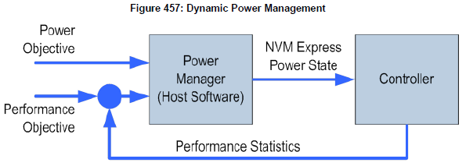
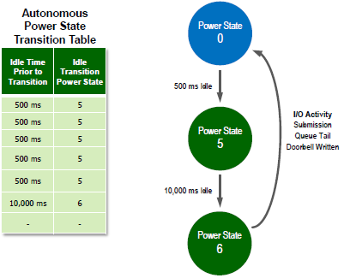
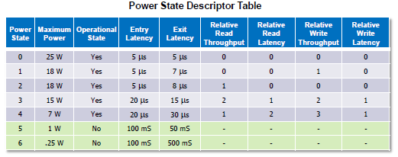
Features
Power Management
The power management capability allows the host to manage NVM subsystem power statically or dynamically.
The number of power states implemented by a controller is returned in the Number of Power States Supported (NPSS) field in the Identify Controller data structure.
Autonomous Power State Transitions provide a mechanism for the host to configure the controller to automatically transition between power states on certain conditions without software intervention.
Notes:
Power states are contiguously numbered starting with zero such that each subsequent power state consumes less than or equal to the maximum power consumed in the previous state. Thus, power state zero indicates the maximum power that the NVM subsystem is capable of consuming.
The maximum amount of time to transition between any two power states is equal to the sum of the old state’s exit latency and the new state’s entry latency.
A lower value means lower write latency.
A lower value means higher write throughput.
No I/O commands are processed by the controller while in a non-operational power state.
Autonomous Power State Transition – Data Structure Entry
Idle Time Prior to Transition (ITPT) + Idle Transition Power State (ITPS)

Slide 44
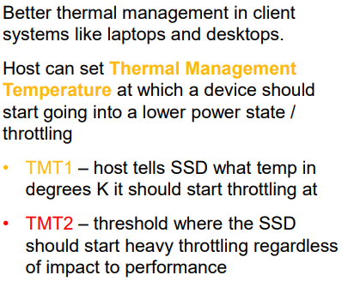
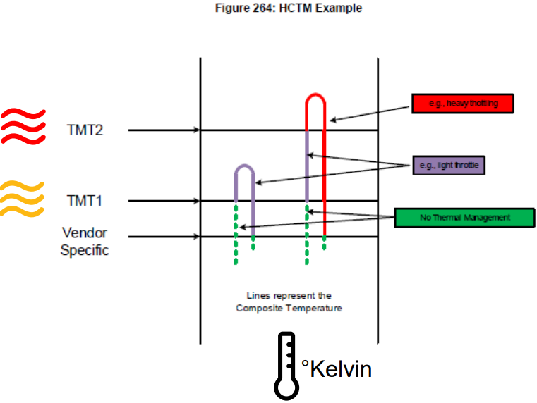
Features
Host Controlled Thermal Management
Notes:
Host controlled thermal management provides a mechanism for the host to configure a controller to automatically transition between active power states or perform vendor specific thermal management actions in order to attempt to meet thermal management requirements specified by the host.
TMT1: the controller should start transitioning to lower power active power states while minimizing the impact on performance in order to attempt to reduce the Composite Temperature (e.g., transition to an active power state that performs light throttling).
TMT2: the controller shall start transitioning to lower power active power states regardless of the impact on performance in order to attempt to reduce the Composite Temperature (e.g., transition to an active power state that performs heavy throttling).

Slide 45
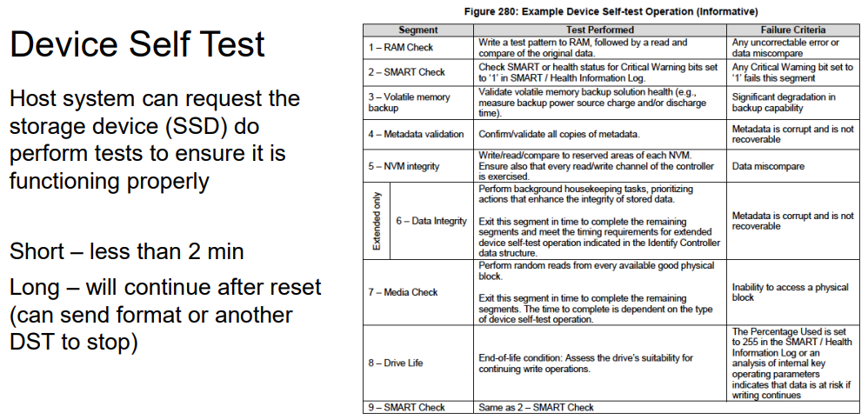
Features
Device Self-test Operations
Notes:
A short device self-test operation should complete in two minutes or less. The percentage complete of operation is indicated in the Current Percentage Complete field in the Device Self-test Log
An extended device self-test operation should complete in the time indicated in Time field in the Identify Controller data structure or less.

Slide 46
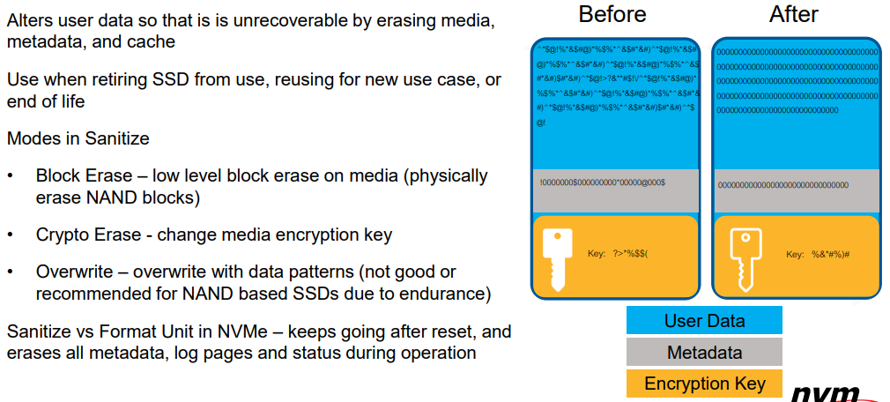
Features
Sanitize Operations
Notes:
Format NVM command, the host requests a format operation and may request a secure erase of the contents of the NVM. There are two types of secure erase. The User Data Erase erases all user content present in the NVM subsystem. The Cryptographic Erase erases all user content present in the NVM subsystem by deleting the encryption key with which the user data was previously encrypted.

Slide 47
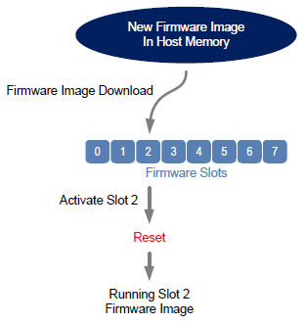
Features
Firmware Update Process
Firmware update to be activated by a reset
Download firmware image to firmware slot
Activate firmware image
Perform reset to cause new firmware image to run
Controller reset
PCIe conventional reset
Subsystem reset
Firmware update to be activated without a reset
Download firmware image to firmware slot
The host submits a Firmware Commit command with a Commit Action of 011b which specifies that the image should be activated immediately without reset.
Notes:
Firmware Image Download command ==Identify Controller Data Structure: Firmware Update Granularity
Firmware Commit command
Get Log Page – Firmware Slot Information Log

Slide 48
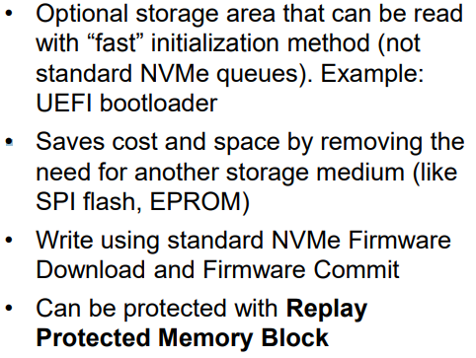
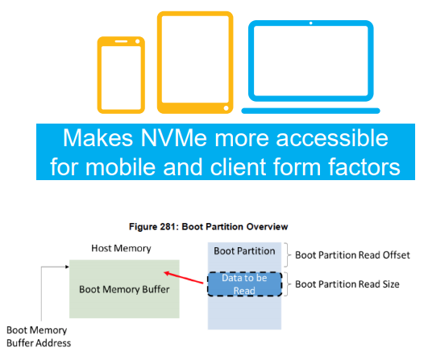
Features
Boot Partitions
Notes:
Defines a simple bootstrap mechanism to initialize the controller without setting up SQ and CQ in memory.
This capability is most often used in mobile systems, and is functionally equivalent to a feature provided in eMMC devices.
Boot Partitions provide an optional area of NVM storage that may be read by the host without the host initializing queues or enabling the controller.
The two Boot Partitions allow the host to update one and verify the contents before marking the Boot Partition active. Controllers in the NVM subsystem may share the same Boot Partitions.
The contents of Boot Partitions are only modified using the Firmware Image Download and Firmware Commit commands and may be secured using Replay Protected Memory Block to prevent unauthorized modifications.
Controller Registers
BPINFO-Boot Partition Information
BPRSEL-Boot Partition Read Select
BPMBL-Boot Partition Memory Buffer Location

Slide 49


Features
Metadata Handling
Metadata is additional data allocated on a per logical block basis. One of the most common usages for metadata is to convey end-to-end protection information.
Contiguous with LBA Data
Transferred as Separate Buffer
Notes:
Extend LBA: client, Separate Buffer: ED
SOC support
Identify – LBA Format Data Structure: LBA Data Size (LBADS)+Metadata Size (MS)
Format NVM – Metadata Settings (MSET)+LBA Format (LBAF)
The mechanism used is selected when the namespace is formatted.
multi-LBA(e.g. 512, 512+8, 4K, 4K+8) vs. multi-NS
NetApp
DIF: contiguous with logical block data
DIX: in separate buffers

Slide 50

Features
End-to-end Data Protection
To provide robust data protection from the application to the NVM media and back to the application itself, end-to-end data protection may be used. This additional protection information, if present, is either the first eight bytes of metadata or the last eight bytes of metadata, based on the format of the namespace.
The Protection Information format is contained in the metadata associated with each logical block.
The Guard field contains a CRC-16 computed over the logical block data.
The Application Tag is an opaque data field not interpreted by the controller.
The Reference Tag associates logical block data with an address and protects against misdirected or out-of-order logical block transfer.
Notes:
Format NVM – Protection Information Location (PIL)+Protection Information (PI)+Metadata Settings (MSET)+LBA Format (LBAF)
Identify Namespace Data Structure: End-to-end Data Protection Capabilities (DPC), End-to-end Data Protection Type Settings (DPS)
A bit in the protection information Application Tag field is masked if the corresponding bit is cleared to ‘0’ in the Logical Block Application Tag Mask (LBATM) field of the command.
If the namespace is formatted for Type 1 or Type 2 protection, then all protection information checks are disabled regardless of the state of the PRCHK field when the protection information Application Tag has a value of FFFFh. If the namespace is formatted for Type 3 protection, then all protection information checks are disabled regardless of the state of the PRCHK field when the protection information Application Tag has a value of FFFFh and the protection information Reference Tag has a value of FFFFFFFFh.

Slide 51


Features
The PRACT Bit
Protection Information(PRINFO) = Protection Information Action(PRACT) + Protection Information Check(PRCHK)
Notes:
PRACT: indicates the action to take for the protection information.
PRCHK: specifies the fields that shall be checked as part of end-to-end data protection processing.
Identify Namespace Data Structure: End-to-end Data Protection Capabilities (DPC), End-to-end Data Protection Type Settings (DPS)
1b 8 Bytes The protection information is stripped (read) or inserted (write).
1b > 8 Bytes The protection information is passed (read) or replaces the first or last 8 bytes of the metadata (write).
0b any The protection information is passed (read and write).
Inserted protection information consists of the computed CRC-16 in the Guard field, the LBAT field value in the Application Tag, and the computed reference tag in the Reference Tag field.

Slide 52
NVM Express™
Directives
Notes:
Directives (optional)
Defines a new mechanism for host to NVM subsystem or host to controller information exchange, including as part of IO (e.g., read, write) commands.
The first major Directive defined is Streams which may be used to optimize data placement to increase endurance for NAND based SSDs.
References:
NVMe revision 1.3 section 9
Technical Proposal 008

Slide 53
Directives
Directives is a mechanism to enable host and NVM subsystem or controller information exchange. The Directive Receive command is used to transfer data related to a specific Directive Type from the controller to the host. The Directive Send command is used to transfer data related to a specific Directive Type from the host to the controller. Other commands may include a Directive Specific value specific for a given Directive Type (e.g., the Write command in the NVM command set).
Directive Use in I/O Commands
In an I/O command, if the Directive Type is set to an I/O Command Directive, then the Directive Specific specifies the identifier of the stream associated with the data. The only I/O command that supports use of directives is the Write command.
Identify (Directive Type 00h)
Directive Receive
The Return Parameters operation returns a data structure that contains a bit vector specifying the Directive Types supported by the controller and a bit vector specifying the Directive Types enabled for the namespace.
Directive Send
The Enable Directive operation is used to enable a specific Directive for use within a namespace by all controllers that are associated with the same Host Identifier.
Notes:
Directives (optional)
Defines a new mechanism for host to NVM subsystem or host to controller information exchange, including as part of IO (e.g., read, write) commands.
The first major Directive defined is Streams which may be used to optimize data placement to increase endurance for NAND based SSDs.
Host Identifier (Feature Identifier 81h
This feature allows the host to register a Host Identifier with the controller. The Host Identifier is used by the controller to determine whether other controllers in the NVM subsystem are associated with the same host. The Host Identifier may be used to designate host elements that access an NVM subsystem independently of each other or for reservations.

Slide 54



Directives
Notes:
Streams (Directive Type 01h)
Standard SSD (No Stream Separation, Single Write Stream)
Mixed data needs garbage collection to reclaim blocks.→Higher write amp
Streaming SSD(Separation of streams into different reclaim units, Individual Write Streams)
Separated data can be trimmed or self-invalidated to reclaim blocks.→Lower write amp

Slide 55

Directives
Streams (Directive Type 01h)
The Streams Directive enables the host to indicate (i.e., by using the stream identifier) to the controller that the specified logical blocks in a write command are part of one group of associated data. This information may be used by the controller to store related data in associated locations or for other performance enhancements.
Data that is aligned to and in multiples of the Stream Write Size (SWS) provides optimal performance of the write commands to the controller. The Stream Granularity Size indicates the size of the media that is prepared as a unit for future allocation for write commands and is a multiple of the Stream Write Size. The controller may allocate and group together a stream in Stream Granularity Size (SGS) units.
Notes:
Stream resources: the resources that are necessary to track operations associated with a specified stream identifier.
Max Stream Limit (MSL): maximum number of stream resources that are available in an NVM subsystem
NVM Subsystem Streams Available (NSSA): stream resources that are not allocated for exclusive use in any namespace.

Slide 56

Directives
Directive Receive
The Return Parameter operation returns a data structure that specifies the features and capabilities supported by the Streams Directive, including namespace specific values.
The Get Status operation returns information about the status of currently open streams for the specified namespace and the host issuing the Get Status operation.
The Allocate Resources operation indicates the number of streams that the host requests for the exclusive use for the specified namespace.
Directive Send
The Release Identifier operation specifies that the stream identifier is no longer in use by the host.
The Release Resources operation is used to release all streams resources allocated for the exclusive use of the namespace attached to all controllers.
Notes:
Return Parameters:
NVM Subsystem: Max Streams Limit (MSL), Streams Available(NSSA), Streams Open(NSSO), Stream Capability( NSSC)
Namespace Specific Fields: Stream Write Size(SWS), Stream Granularity Size(SGS)
Namespace and Host Identifier Specific Fields: Namespace Streams Allocated(NSA), Namespace Streams Open(NSO)
Get Status:
Open Stream Count: number of streams that are currently open.
Stream Identifier 1: the stream identifier of the first (numerically lowest) open stream. ~ Stream Identifier 65,535
Allocate Resources:
Namespace Streams Requested (NSR): the number of stream resources the host is requesting be allocated by namespace
Namespace Streams Allocated (NSA): the number of streams resources that have been allocated by namespace. available to all controllers associated with that host.

Slide 57
NVM Express™
Changes in NVMe 1.4
Notes:
One category of changes is new features that are optional capabilities. These features may be implemented by a revision 1.4 compatible device based on market need.
Another category is changes from past behavior. One set of changes here includes extensions of past functionality. Another set of changes is incompatible changes from past behavior, or new mandatory requirements for how a feature shall be implemented

Slide 58
Changes in NVMe 1.4
New Features (optional)
Persistent Memory Region
IO Determinism
Asymmetric Namespace Access
Namespace Write Protect
Persistent Event Log
Rebuild Assist
NVM Sets
Read Recovery Levels
Endurance Groups
IO Performance and Endurance Hints
Verify Command
Administrative Controller
Notes:
One category of changes is new features that are optional capabilities. These features may be implemented by a revision 1.4 compatible device based on market need.
Another category is changes from past behavior. One set of changes here includes extensions of past functionality. Another set of changes is incompatible changes from past behavior, or new mandatory requirements for how a feature shall be implemented

Slide 59
Changes in NVMe 1.4
Feature Enhancements
Host Memory Buffer Enhancements
Namespace Granularity
Transport SGL
Sanitize Enhancements
Shared Stream Write
Enhanced Command Retry
Controller Memory Buffer Extensions
Notes:
One category of changes is new features that are optional capabilities. These features may be implemented by a revision 1.4 compatible device based on market need.
Another category is changes from past behavior. One set of changes here includes extensions of past functionality. Another set of changes is incompatible changes from past behavior, or new mandatory requirements for how a feature shall be implemented

Slide 60
Changes in NVMe 1.4
Required Changes
New NSID value usages
New errors and reporting requirements
Temperature threshold clarifications
Controller Memory Buffer & Persistent Memory Region Enhancements
New Sanitize requirements
Reservation Notification Log usage
Clarified LBA Range feature behavior
Reservation Report command conflicts resolved
New Abort command behavior
Clarified Device Self-Test termination on Format scenario
Release of Stream Resources clarification
* Not to scale. These are categories of changes, not the full list of changes themselves
Notes:
Clarifications regarding various usages of NSID value FFFFFFFFh (mandatory)
Number of Queues feature undefined error
Unsupported Fused Operation error clarification
Error definition for Format command overlap with other commands
Security Receive and Security Send specified undefined failure status code
Clarify inconsistent temperature thresholds
SMART Critical Composite Temperature Time definition change
Sanitize Capabilities value when Sanitize command is not supported
Sanitize during Device Self-Test
Idle Power and Sanitize interaction clarification
Reservation Notification Log maximum pages reached
LBA Range feature results with multiple Set Feature commands processed
Abort command completion
Changes in NVMe Revision 1.4

Slide 61
Changes in NVMe 1.4
Example: Mandatory Change NSID value - FFFFFFFFh
Overview – Namespace Identifiers
All usages of NSID value FFFFFFFF are now well-defined
Generally used to mean a broadcast action against all Namespaces
What are the changes?
Clarifications in many sections: I/O Commands, Set/Get Features, Admin Commands, and Reservations
Explicitly defines when NSID of FFFFFFFF can be used and how to use it
Why the changes?
The specification was quiet on a number of use cases
Need to provide consistency across Device and OS implementations
Improve the end-user experience and ease of NVMe™ device consumption
Impacts of inaction
Inconsistent results when using devices from various hardware vendors
Notes:
The capabilities and settings that are common to all namespaces are reported by the Identify Namespace data structure for namespace ID FFFFFFFFh.

Slide 62
NVM Express™ Management Interface
Introduction

Slide 63
The Importance of Manageability in Servers
Availability
“Customers choose suppliers who provide the features
that are important to them. Customers care about TCO
(Total Cost of Ownership). Consequently, in the server
space, MHz is not the only thing that's important:
TCO is greatly affected by the RASM features of the
servers. When server OEMs and users talk, their focus
is RASM: Reliability, Availability, Serviceability, and
Manageability. To a customer, RASM means dollars.
Adding or improving on RASM reduces TCO. The cost of downtime is extremely high. According to
IMEX Research, the average cost of an unplanned
outage runs into the hundreds of thousand of dollars.”
A measure of system uptime.
Unreliable components, inability
to manage, and inability to service
reduce availability.
Reliability
Serviceability
A measure of the reliability of
systems and components. Better
reliability increases availability
and reduces replacement
cost.
A measure of how easy it is to
recover a system to full operation
following a failure.
RASM
Manageability
A measure of how easy it is to
inventory systems/components,
configure, perform updates,
and monitor and
report failures.
Better RASM = Reduced TCO

Slide 64
Management Fundamentals
Management Operational Times
Deployment (No OS)
Pre-OS (e.g., UEFI/BIOS)
Runtime
Auxiliary Power
Decommissioning
Pillars of Systems Management
Inventorying
Configuration
Monitoring
Change Management

Slide 65

Sample Use Cases

Slide 66
What is the NVMe™ Management Interface?
Allows a Management Controller to communicate out-of-band with an NVMe Storage Device or NVMe Enclosure over one or more external interfaces.
The in-band tunneling mechanism which allows the NVMe-MI Management Interface Command Set to be tunneled in-band via the NVMe Admin Commands NVMe-MI Send and NVMe-MI Receive to an NVMe Storage Device or NVMe Enclosure.
Management Controller – A device (e.g., Baseboard Management Controller) responsible for platform management that uses the NVM Express Management Interface to communicate to Management Endpoints.
out-of-band management – A management that operates with hardware resources and components that are independent of the operating system’s control.
in-band management – A management that operates with the support of hardware components that are critical to and used by the operating system.
NVMe Storage Device – A logical or physical component, device, or assembly that contains at least one NVM Subsystem or Expansion Connector, at least one Upstream Connector, and at least one FRU Information Device.
NVMe Enclosure – A platform, card, module, box, rack, or set of boxes that may provide power, cooling, mechanical protection and/or external interfaces for zero or more NVMe Storage Device FRUs. An NVMe Enclosure contains one or more NVM Subsystems and one or more Enclosure Services Processes.
Notes:
As NVMe Spec Roadmap
Out-of-Band Management for NVMe-MI in 1.0
In-Band Management for NVMe-MI in 1.1
Discuss both later individually

Slide 67
NVM Express™ Management Interface
Theory & Architecture
Notes:
NVMe Basic Management Command: defined as a whitepaper to allow rudimentary out-of-band management of NVMe as a stop-gap until the NVMe-MI 1.0 Specification was released
defined in an informative appendix in the NVMe-MI Specification, but is NOT part of NVMe-MI
The NVMe-MI Workgroup and Board have agreed that there will be no further enhancements
Deprecated in 1.1

Slide 68


FRU Information Device
Field-Replaceable Unit (FRU)
A physical component, device, or assembly in a system that is able to be removed and replaced (e.g., by an end user or technician) without having to replace the entire system in which it is contained.
FRU Information Device
A logical or physical device used to hold the Vital Product Data (VPD). A FRU Information Device may be implemented in a variety of ways (e.g., a serial EEPROM, one-time programmable memory in silicon, etc.).
NVMe Storage Device FRU
An NVMe Storage Device that is able to be removed and replaced (e.g., by an end user or technician) without having to replace the entire system in which it is contained. Examples of NVMe Storage Device Field-Replaceable Units include a U.2 PCIe SSD, a PCI Express Card Electromechanical add-in card, or an M.2 module.
Notes:
The FRU described in MI is an NVMe Storage Device FRU

Slide 69

Vital Product Data (VPD)
The Vital Product Data (VPD) is information describing an NVMe Storage Device. Each NVMe Storage Device FRU shall have a FRU Information Device with a size of 256 bytes to hold the VPD as defined in the IPMI Platform Management FRU Information Storage Definition.
The VPD may be accessed using two methods
NVMe-MI commands over MCTP
SMBus/I2C interface using I2C operations as defined by IMPI Platform Management FRU Information Storage Definition
The VPD for NVMe Storage Device FRUs shall contain the required elements:
Notes:
The IPMI (Intelligent Platform Management Interface) is a set of industry standard specifications for hardware-based subsystems that provide management and monitoring capabilities independently of the host system's CPU, firmware and operating system.
NVMe MultiRecord Area - form factor, power requirements, and capacity
NVMe PCIe Port MultiRecord Area - PCIe Link Speed & Width
Topology MultiRecord Area - NVMe Storage Device’s architectural elements and their connections.

Slide 70
NVMe-MITM Out-of-Band Protocol Layering
Notes:
The out-of-band mechanism utilizes the Management Component Transport Protocol (MCTP) as the transport and utilizes existing MCTP SMBus/I2C and PCIe bindings for the physical layer. Command Messages are submitted to one of two Command Slots associated with a Management Endpoint contained in an NVM Subsystem.

Slide 71
Out-of-Band Management and NVMe-MITM in 1.0
Out-of-Band Management – Management that operates with hardware resources and components that are independent of the host operating system control
NVMe Out-of-Band Management Interfaces
SMBus/I2C
PCIe Vendor Defined Messages (VDM)
Notes:
The out-of-band communication paths supported by MI are via MCTP over SMBus/I2C or MCTP over PCIe VDM from a Management Controller to a Management Endpoint.
The in-band communication path defined by MI is via the NVMe Admin Queue using the NVMe-MI Send and NVMe-MI Receive commands from host software to an NVMe Controller.
A baseboard management controller (BMC) is a small, specialized processor used for remote monitoring and management of a host system, it is commonly located on the main motherboard of the computer, server, network or storage device (the "baseboard"), can be accessed remotely either via a dedicated or shared network connection, and has multiple connections to the host system, giving it an ability to monitor hardware via sensors, flash BIOS/ UEFI firmware, give console access via serial or physical / virtual KVM, power cycle the host, and log events.
The key advantage of a BMC is that allows a system administrator to perform many different monitoring and management tasks remotely without having to be physically located next to and connected to the system – such as power cycling, installing BIOS or firmware updates, and monitoring fan speeds and temperatures. The BMC will also notify the administrator (via email or text message) if there is hardware failure (such as a hard drive, fan or PSU that needs replacing) or if there is another kind of error or fault.
Used together with a BMC (Baseboard Management Controller), IPMI allows a system administrator to perform many different monitoring and management tasks remotely without having to be physically located next to and connected to the system – such as power cycling a server, installing BIOS or firmware updates, and monitoring fan speeds and temperatures.

Slide 72
In-Band Management and NVMe-MITM in 1.1
In-band mechanism allows application to tunnel NVMe-MI commands through NVMe driver
Two new NVMe Admin commands
NVMe-MI Send
NVMe-MI Receive
Benefits
Provides management capabilities not available in-band via NVMe commands
Efficient NVM Subsystem health status reporting
Ability to manage NVMe at a FRU level Vital Product Data (VPD) access
Enclosure management
Notes:
The in-band communication path defined by MI is via the NVMe Admin Queue using the NVMe-MI Send and NVMe-MI Receive commands from host software to an NVMe Controller.

Slide 73


NVM Subsystem Architectural Model
NVM Subsystem - NVMe-MI extends the definition of an NVM Subsystem defined in the NVM Express specification (e.g., by adding a Management Endpoint, Controller Management Interface, etc.). NVMe Enclosures and NVMe Storages devices that are not Carriers have one or more NVM Subsystems. Carriers have zero or more NVM Subsystems.
NVM Subsystem Associated with Single PCIe Port
NVM Subsystem with Dual Ported PCIe Ports and an SMBus/I2C Port

Slide 74




NVMe Storage Device Architectural Model
NVMe Storage Device – A logical or physical component, device, or assembly that contains at least one NVM Subsystem or Expansion Connector, at least one Upstream Connector, and at least one FRU Information Device.
Notes:
An NVMe Storage Device that implements the out-of-band mechanism contains at least one Management Endpoint and a Controller Management Interface per Controller. An NVMe Storage Device contains zero or more PCIe switches and SMBus/I2C Muxes.

Slide 75


NVMe Storage Device Architectural Model

Slide 76

NVMe Storage Device with Multiple NVM Subsystems

Slide 77


NVMe JBOF (Just a Bunch Of Flash)
Facebook Lightning PCIe NVMe JBOF
Notes:
#support a variety of SSD form factors, including 2.5", M.2, and 3.5" SSDs.
#support surprise hot-add and surprise hot-removal of SSDs to make field replacements as simple and transparent as SAS JBODs.
#use an ASPEED AST2400 BMC chip running OpenBMC.
#support multiple switch configurations, which allows us to support different SSD configurations (for example, 15x x4 SSDs vs. 30x x2 SSDs) or different head node to SSD mappings without changing HW in any way.
#capable of supporting up to four head nodes. By supporting multiple head nodes per tray, we can adjust the compute-to-storage ratio as needed simply by changing the switch configuration.

Slide 78


NVMe Enclosure Architectural Model
NVMe Enclosure – A platform, card, module, box, rack, or set of boxes that may provide power, cooling, mechanical protection and/or external interfaces for zero or more NVMe Storage Device FRUs. An NVMe Enclosure contains one or more NVM Subsystems and one or more Enclosure Services Processes.

Slide 79


NVMe Enclosure Architectural Model
Enclosure Services Process – A process that implements Enclosure services for an NVMe Enclosure that supports Enclosure Management.

Slide 80




SMBus Topology for NVMe-MI
Notes:
ARP(Address Resolution Protocol) support on SMBus/I2C elements is optional unless there are multiple SMBus/I2C elements in the NVMe Storage Device or NVMe Enclosure with the same default SMBus/I2C address are present on the same SMBus/I2C channel.

Slide 81
NVM Express™ Management Interface
Message Transport
Notes:
This specification defines an interface that supports multiple message transports. The message format is
the same for the out-of-band mechanism and the in-band tunneling mechanism and is described in section
3.1. The out-of-band message transport is described in section 3.2. The in-band tunneling message
transport is described in section 3.3.
The out-of-band mechanism defined in this specification utilizes MCTP as a reliable in-order message
transport between a Management Controller and a Management Endpoint.
The in-band tunneling mechanism in this specification utilizes the NVMe Admin Commands NVMe-MI Send and NVMe-MI Receive as a message transport.

Slide 82

Message Transport
NVMe-MI Messages– In the out-of-band mechanism, an NVMe-MI Message consists of the payload of one or more MCTP packets. The maximum sized NVMe-MI Message is 4,224 bytes (i.e., 4 KiB + 128 bytes). In the in-band tunneling mechanism, NVMe-MI Messages are not split into MCTP packets and the maximum NVMe-MI message size is equal to the Maximum Data Transfer Size.
Notes:
4,224 bytes (i.e., 4 KiB + 128 bytes). Refer to the NVMe Management Messages over MCTP Binding Specification
Maximum Data Transfer Size (refer to the NVM Express specification).
The format of an NVMe-MI Message consists of a Message Header in the first dword, followed by the
Message Data. If the Integrity Check (IC) bit is set to ‘1’, then the NVMe-MI Message ends with the Message
Integrity Check as shown in Figure 17.
The IC field shall be set to ‘1’ in all NVMe-MI Messages in the out-of-band mechanism. The Integrity Check (IC) bit shall be cleared to ‘0’ in all NVMe-MI Messages in the in-band tunneling mechanism.

Slide 83


Message Transport

Slide 84


Message Transport
Notes:
In the MCTP Base Specification, the smallest unit of data transfer is the MCTP packet. One or more packets
are combined to create an MCTP message. In this specification, the MCTP messages are referred to as
NVMe-MI Messages
The Physical Medium-Specific Header and Physical Medium-Specific Trailer are defined by the MCTP transport binding specification utilized by the port. Refer to the MCTP transport binding specifications.

Slide 85



Message Transport

Slide 86

Message Transport
Notes:
An example NVMe-MI Message whose contents are split across four MCTP packets is shown in Figure 22.

Slide 87
NVM Express™ Management Interface
Message Servicing Model

Slide 88

Message Servicing Model
Notes:
The two main categories of NVMe-MI Messages are Request Messages and Response Messages. Request Messages are sent by a Management Controller to a Management Endpoint when using the out-of-band mechanism. Request Messages are sent by host software to an NVMe Controller when using the in-band tunneling mechanism. The entity sending the Request Message is collectively referred to as the Requester and the entity receiving the Request
Message is collectively referred to as the Responder. After receiving a Request Message, the Responder
processes the Request Message. When processing is complete, the Responder sends a Response
Message back to the Requester.
A Request Message may be classified as a Command Message or a Control Primitive. Command
Messages specify an operation to be performed by the Responder and may be further classified as an
NVMe-MI Command, an NVMe Admin Command, or a PCIe Command. Control Primitives are used in the
out-of-band mechanism to affect the servicing of a previously issued Command Message or get the state
of a Command Slot and Management Endpoint.
A Response Message may be classified as a Success Response or an Error Response.

Slide 89


Message Servicing Model
Notes:
Request Messages are NVMe-MI Messages that are generated by a Requester to send to a Responder.
specify an action to be performed by the Responder. are either Control Primitives or Command Messages. The format of the Message Body for a Command Message is command set specific and is specified by the NMIMT field in the Message Header.
The NVMe Management Interface supports three command sets:
NVMe-MI Command, an NVMe Admin Command, or a PCIe Command
Response Messages are NVMe-MI Messages that are generated when a Responder completes processing
of a previously issued Request Message.

Slide 90


Message Servicing Model
Notes:
4.1.2.1 Generic Error Response
A Generic Error Response is generated for errors in which no additional information is provided beyond the
Response Message Status.
4.1.2.2 Invalid Parameter Error Response
An Invalid Parameter Error Response is generated for Error Responses where the Status field is set to
Invalid Parameter. Invalid Parameter Error Response Fields: Parameter Error Location (PEL)

Slide 91

Message Servicing Model
Out-of-Band Message Servicing Model– The out-of-band mechanism utilizes a request and response servicing model. A Management Controller sends a Request Message to a Management Endpoint, the Management Endpoint processes the Request Message, and when processing has completed, sends a Response Message back the Management Controller.
Notes:
1. Idle: This is the default state of the command servicing state machine (e.g., following a reset).
Command servicing transitions from Idle to the Receive state when the first MCTP packet of a
Command Message is received.
2. Receive: The state when the first packet of a Command Message has been received and the
message is being assembled and/or validated. Command servicing transitions from Receive to the
Idle state when an Abort Control Primitive is received, an error is detected in message assembly, or the Message Integrity Check fails. Command servicing transitions from Receive state to the Process state when a Command Message is assembled and the message integrity check is successful.
3. Process: The state when a Command Message is processed. Processing of a Command Message
consists of checking for errors with the Command Message and performing the actions specified
by the Command Message or aborting the Command Message. Command servicing transitions
from Process to the Transmit state when a Response Message is required to be sent. Command servicing transitions from the Process state to the Idle state due to an Abort Control Primitive.
4. Transmit: The state in which a Response Message for the Command Message is transmitted to
the Management Controller. Command servicing transitions from the Transmit to the Idle state once
the entire NVMe-MI Message associated with the response to the Command Message has been
transmitted on the physical medium or due to an Abort Control Primitive. If command servicing did not complete in the Process state, then the Management Endpoint transmits a Response Message with status More Processing Required and the command servicing transitions back to the Process state.

Slide 92


Message Servicing Model
Control Primitives– Control Primitives are Request Messages sent from a Management Controller to a Management Endpoint to affect the servicing of a previously issued Command Message or get the state of a Command Slot and Management Endpoint.
Notes:
Control Primitives are applicable only in the out-of-band mechanism and are
prohibited in the in-band tunneling mechanism.

Slide 93


Message Servicing Model
In-Band Tunneling Message Servicing Model– The in-band tunneling mechanism in this specification utilizes two NVMe Admin Commands (NVMe-MI Send and NVMe-MI Receive).
The NVMe-MI Send command is used to tunnel an NVMe-MI Command from host software to an NVMe Controller that transfers data from the host to the NVMe Controller (similar to a write operation) or to instruct the Management Endpoint to perform an action (e.g., to reset the NVM Subsystem using the Reset command).

Slide 94

Message Servicing Model
The NVMe-MI Receive command is used to tunnel an NVMe-MI Command from a host to an NVMe Controller that transfers data from the NVMe Controller to the host (similar to a read operation).

Slide 95
NVM Express™ Management Interface
Command Set
Notes:
Command Messages specify an operation to be performed by the Responder and may be further classified as an
NVMe-MI Command, an NVMe Admin Command, or a PCIe Command.

Slide 96



Management Interface Command Set
Notes:
The Management Interface Command Set defines the Command Messages that may be submitted by a
Requester when the NMIMT value is set to NVMe-MI Command. The Management Interface Command
Set is applicable to both the out-of-band mechanism and the in-band tunneling mechanism.

Slide 97



NVM Express Admin Command Set
Notes:
The NVM Express Admin Command Set allows NVMe Admin Commands to be issued to any Controller in the NVM Subsystem using the out-of-band mechanism.

Slide 98



PCIe Command Set
Notes:
The PCIe Command Set defines optional commands that a Management Controller may submit to access
the memory, I/O, and configuration addresses spaces associated with a Controller in the NVM Subsystem.
The PCIe Command Set is only applicable in the out-of-band mechanism and is prohibited in the in-band tunneling mechanism.

Slide 99


NVM Express Management Enhancements
Notes:
This section describes NVMe Management Interface enhancements to the NVM Express specification.
8.1 Identify Controller
The NVMe Identify Controller data structure contains information about an NVMe Controller. Byte 240 to byte 255 have been allocated by the NVM Express specification for this specification and are defined below.
8.2 Management Interface Specific Features
The NVMe Get Features and Set Features Admin commands are used to retrieve and modify Feature values. Feature Identifiers 78h to 7Fh have been allocated by the NVM Express specification for this specification and are defined below.

Slide 100

Out-of-Band Operational Times
Notes:
This section enumerates Management Endpoint operational times and the operations supported in each of these operational times.
The NVM Subsystem power state is defined by the state of main power and auxiliary power.
Main power consists of one or more voltage rails as defined by form factor. When main power consists of multiple voltage rails, main power is considered “on” when power is good on all main voltage rails.
Auxiliary power is optionally supported by a form factor and enables SMBus/I2C communications in the absence of main power.
Only the Powered On and Powered Off states are applicable in form factors and platforms that do not support auxiliary power.

Slide 101
NVM Express™ Management Interface
Examples
Notes:
This section contains example NVMe-MI Messages over SMBus/I2c between a Management Controller (e.g., a Baseboard Management Controller) and a Management Endpoint.

Slide 102
Example NVMe-MI Messages over SMBus/I2C
The Request Messages are sent from the Management Controller to the Management Endpoint and the corresponding Response Messages are sent back from the Management Endpoint to the Management Controller.
The examples assume the following:
Management Endpoint SMBus/I2C address is 3Ah;
Management Controller SMBus/I2C address is 20h;
Management Endpoint MCTP Endpoint ID is 0, examples only use SMBus/I2C address;
Management Controller MCTP Endpoint ID is 0, examples only use SMBus/I2C address;
MCTP Transmission Unit Size is 64 bytes;
NVMe Storage Device Composite Temperature (CTEMP) is 30 °C;
NVMe Storage Device Controller ID is 1; and
NVMe Storage Device Serial Number is AZ123456.
Notes:
The first 4 bytes and the last byte of each packet (shown in orange in the examples below) are defined by the MCTP SMBus/I2C Transport Binding Specification. Bytes 4 to 7 of each packet and the Message Integrity Check (green) are defined by the MCTP Base Specification. The CRC-32C algorithm and the NVMe-MI Message Header (blue) are defined in section 3.1.1.1. Management Controller transmission bytes are shown in white blocks and Management Endpoint transmission bytes are shown in grey blocks.

Slide 103

Example NVMe-MI Messages over SMBus/I2C
Data Transfers On SMBus: Every byte consists of 8 bits. Each byte transferred on the bus must be followed by an acknowledge bit. Bytes are transferred with the most significant bit (MSB) first.
Packet Error Checking: The Packet Error Checking mechanism improves reliability and communication robustness, whenever applicable, is implemented by appending a Packet Error Code (PEC) at the end of each message transfer. The PEC is a CRC-8 error-checking byte, calculated on all the message bytes (including addresses and read/write bits). The PEC is appended to the message by the device that supplied the last data byte.
Notes:
START Condition(Data Line Falling While Clock Line Is High)
STOP Condition(Data Line Rising While Clock Line Is High)
Differences between SMBus and I2C:
VDD And Threshold Voltage Differences
Minimum Bus Speed And Maximum Clock Stretching
Address Acknowledge
SMBus Protocols
REPEATED START Condition
SMBus Low Power Version

Slide 104

Example NVMe-MI Messages over SMBus/I2C
Example 1: In this example, a Management Controller issues an Identify Command to read the Serial Number (bytes 23:04 of the Identify Controller Data Structure) of an NVMe Storage Device. The NVMe Storage Device’s response is shown in the Example 2.
Notes:
The first 4 bytes and the last byte of each packet (orange) are Physical Medium Specific Header and Trailer(MCTP over SMBus/I2C Binding)
Bytes 4 to 7 of each packet are MCTP Packet Header. (MCTP)(Transport Layer)
NVMe-MI Message Header (blue), Message Integrity Check (green) (NVMe Management Interface)(Protocol Layer)
Management Controller transmission bytes are shown in white blocks
Management Endpoint transmission bytes are shown in grey blocks.
The Request Message is longer than the default 64-byte MCTP Transmission Unit Size and thus spans two MCTP packets. The NVMe-MI Message Type (NMIMT) field specifies that this is an NVMe Admin Command. The NVMe Opcode 06h specifies that this is an Identify Command. This NVMe Opcode and the required values for Dwords 1 to 15 are defined in the NVM Express specification for the Identify Command. The Data Offset of 00000004h skips the first 4 bytes of the Identify Controller Data Structure response. The Data Length of 00000014h limits the response to 20 bytes.
Notice that the blue header is only present in the first packet of a message. The MCTP packet sequence number is incremented from 0 for the first packet to 1 for the second packet. The SMBus PEC is calculated per packet and includes every byte sent. The Message Integrity Check is calculated across both packet payloads but skips all orange and green bytes. The value for SMBus Length field (Byte 2) is the number of bytes following it in the packet, not including the SMBus PEC field per the SMBus Specification.

Slide 105

Example NVMe-MI Messages over SMBus/I2C
Example 2: This example shows an NVMe Storage Device’s Response Message to the Identify Command from Example 1. This message is small enough to fit in a single packet so both MCTP SOM and EOM flags are set. The NVM Express specification defines the format (Dwords 0, 1, and 3) of the Identify Controller Data Structure bytes that are returned.
Notes:
Note that the SMBus/I2C addresses and MCTP Endpoint IDs in the Response Message are swapped from
their order in the Request Message. Also note that the incrementing MCTP packet sequence number for
the Management Endpoint is independent from the Management Controller’s MCTP packet sequence
number.

Slide 106


Example NVMe-MI Messages over SMBus/I2C
Example 3: In this example, a Management Controller issues an NVM Subsystem Health Status Poll command and clears the Composite Controller Status.
Example 4: This example shows an NVMe Storage Device’s response to the NVM Subsystem Health Status Poll command from Example 3.
Notes:
Example 3: Note that the MCTP packet sequence number is incremented from the last packet the Management Controller sent in Example 1. The NVMe-MI Message Type value of 08h with Opcode 01h makes this an NVM Subsystem Health Status Poll command. Bit 31 of
Dword1 set to ‘1’ clears the Composite Controller Status after preparing the response.
Example 4: Note that the MCTP packet sequence number is incremented from the last packet the NVMe Storage Device sent in Example 2. Controller ID 0 had a reportable trigger due to its composite temperature change.

Slide 107


Example NVMe-MI Messages over SMBus/I2C
Example 5: This example shows a Management Controller issuing a Replay Control Primitive.
Example 6: This example shows an NVMe Storage Device sending an acknowledgement Response Message to the Replay Control Primitive and then sending a second Response Message that replays the previous Response Message from specified offset of zero.
Notes:
Example 5: The Management Controller may choose to replay an entire Response Message if, for example, the Message
Integrity Check failed on the initial Response Message. Or the Management Controller may choose to replay a partial message starting at a specified MCTP Transmission Unit Size boundary if, for example, the SMBus PEC failed on an individual packet. The Control Primitive Tag is arbitrarily set to 45h and remembered by the Management Controller to match response packets to the correct Control Primitives.
Example 6: Note that the previous command is not reissued because that could return different data after having the Composite Controller Status cleared.

Slide 108
Denali Open-Channel SSDs
Introduction
Notes:
2018 Flash Memory Summit
SM2270 SSD controller is designed with standard NVMe™ and Open Channel capabilities for enterprise and data center storage
The dual-mode SM2270 is a complete SSD controller solution with customer specific or turnkey firmware that can support Open Channel storage implementations as well as standard NVMe protocols.
Support Open Channel implementations such as the Microsoft Denali pre-standard
"The SM2270 is the world's first PCIe SSD controller that supports standard NVMe and Open Channel technology to be available in production. It draws on Silicon Motion's leadership position in flash controller technology and unrivaled knowledge of the data center SSD storage systems," said Wallace C. Kou, President and CEO of Silicon Motion. "This combination makes the SM2270 the ideal controller in SSDs for demanding cloud server and data center applications."
2019 Flash Memory Summit
SSD Controllers for Enterprise / Data Center
SM2270: PCIe Gen3 x8 NVMe 1.3 SSD controller supported with standard turnkey NVMe and Open Channel firmware
Milestones 2019 Ships Open Channel SSDs with our enterprise SSD controllers to two of China's top three hyperscalers

Slide 109

Introduction
SM2270
Silicon Motion Announces New Dual-Mode Enterprise Class SSD Controller Solution at 2018 Flash Memory Summit:
SM2270 SSD controller is designed with standard NVMe™ and Open Channel capabilities for enterprise and data center storage
The dual-mode SM2270 is a complete SSD controller solution with customer specific or turnkey firmware that can support Open Channel storage implementations as well as standard NVMe protocols.
"The SM2270 is the world's first PCIe SSD controller that supports standard NVMe and Open Channel technology to be available in production. It draws on Silicon Motion's leadership position in flash controller technology and unrivaled knowledge of the data center SSD storage systems," said Wallace C. Kou, President and CEO of Silicon Motion. "This combination makes the SM2270 the ideal controller in SSDs for demanding cloud server and data center applications."
Notes:
Milestones 2019 Ships Open Channel SSDs with our enterprise SSD controllers to two of China's top three hyperscalers (Alibaba, Baidu)

Slide 110

Introduction
Open-Channel
A new class of SSDs has been developed known as Open-Channel SSDs. Open-Channel SSDs differ from a traditional SSD in that they expose the internal parallelism of the SSD to the host and allows it manage it. This allows Open-Channel SSDs to provide three properties to the host:
I/O Isolation
I/O isolation provides a method to divide the capacity of the SSD into a number of I/O channels that map the parallel units of the device. This enables an Open-Channel SSD to be used in multi-tenant applications without tenants interfering with each other.
Predictable latency
Predictable latency is achieved by having control in the host over when, where and how I/O are submitted to the SSD.
Software-Defined Non-Volatile Memory
By integrating the SSD flash translation layer into the host, workload optimizations can be applied either within a self-contained flash translation layer, file-system integration or applications themselves.
Host-Managed Non-Volatile Memory Management
Enables the host to control data placement, I/O scheduling and implement tight integrations with file-systems and applications.
Notes:
Figure 1 shows the division of responsibility between the host and SSD. The host implements generic mapping functionality: data placement, I/O scheduling and garbage collection; and can expose a host defined storage interface to higher level applications. The SSD manages media-centric metadata, error handling, scrubbing and wear-leveling and exposes an abstract interface for the host to control.
Figure 1 shows the division of responsibility between the host and SSD. The host implements generic FTL functionality in the host: data placement, I/O scheduling and GC; and exposes a traditional block device to user space. Media-centric metadata, error handling, scrubbing and wear-leveling are handled by the controller. In this way, the host can manage tradeoffs related to throughput, latency, power consumption and capacity. This division of labor between the SSD and host makes it possible to an Open-Channel SSD to abstract the actual media, while allowing the host to have control over all I/Os being submitted to the media.

Slide 111

Introduction
Open-Channel
An open-channel solid state drive is a solid-state drive which does not have a firmware Flash Translation Layer implemented on the device, but instead leaves the management of the physical solid-state storage to the computer's operating system. The interface used by the operating system to access open-channel solid state drives is called LightNVM.

Slide 112

Introduction
Microsoft Denali
Project Denali is a standardization and evolution of Open Channel that defines the roles of SSD vs. that of the host in a standard interface. Media management, error correction, mapping of bad blocks and other functionality specific to the flash generation stays on the device while the host receives random writes, transmits streams of sequential writes, maintains the address map, and performs garbage collection. Denali allows for support of FPGAs or microcontrollers on the host side.
Notes:
SM2270: Support Open Channel implementations such as the Microsoft Denali pre-standard
Microsoft launched a new project today that’s designed to help make flash storage more useful to large enterprises and cloud providers. Called Project Denali, it’s supposed to help deal with several issues with implementing solid state drives in large scale datacenters.
Denali works by splitting apart the monolithic components of an SSD into two different modules. The drive deals with bad blocks, media, and power failures, presenting a set of clean memory blocks. Companies can then create an optimized software interface to handle tasks like garbage collection and wear leveling, based on the applications that they run.

Slide 113


Introduction
Theory of Operation
A group is a shared bus within the Open-Channel SSD, where bandwidth and transfer overhead are shared between the parallel units attached. A parallel unit is the unit of parallelism within the SSD, and its access is fully independent of other parallel units. Note that the representation is not necessarily the physical media attachments and can be a logical representation.
Within Parallel units, there is a set of chunks. The chunks represent a linear range of logical blocks. The chunks require that writes to them are issued sequentially and that a chunk is reset before being written to again.
This hierarchical representation allows the host to control which parallel unit is accessed independently from other parallel units. The SSD firmware should not be optimized for any particular workload, as the host will manage access to the parallel units and which chunks are accessed, such that the host can manage the SSD characteristics with respect to parallelism.
Notes:
parallel unit (PU): Refers to a single parallel unit within the storage media. A single SSD may contain tens or hundreds of these parallel units.
group: Refers to a set of parallel units that share the same transfer bus within the open-channel SSD.
chunk: Refers to a set of contiguous logical blocks. The blocks shall be written sequentially within the chunk. A chunk is the smallest range of logical blocks that can be reset as a unit.
The size of each field is defined by the Geometry command.

Slide 114


Introduction
Theory of Operation
There are three I/O command types: Read, Write and Reset. Data can be retrieved from a chunk by issuing reads. The minimum read size is the logical block size. To write data, the host must write sequentially within a chunk, and each command must fulfill the minimum write unit size. After a chunk is fully written, the chunk must be reset by the host before it can be written again.
Each chunk maintains at least four fields: A start LBA (SLBA), number of logical blocks (NLB), write pointer (WP), and chunk state (CS). They are used to communicate the start of the chunk, its size, when a chunk is open, and the number of logical blocks that have been written within a chunk.
The state field defines the state of a chunk. It can be either (i) free, (ii) open, (iii) closed, or (iv) offline. During the lifetime of a chunk, it cycles through (i-iii), whereas, at the end of its lifetime, its state becomes (iv) offline.
Notes:
If write pointer equals 0, the chunk state is “free”, and if the write pointer is greater than zero and less than SLBA + NLB, the chunk is “open” or “closed”. If WP = SLBA + NLB, the chunk is “closed”. The state of a chunk is implicitly set to "open" when writing to it. Additionally, if the controller namespace supports "multiple resets during free state", the chunk may be reset multiple times while in its “free” state.
An “open” chunk allows reads up till the write pointer. However, if “Cache Minimum Write Size Units” is active. Reads are only allowed up to “WP - the cached units”. When a chunk is in its “closed” state, logical blocks up till the write pointer address can all be accessed.
The final state of a chunk is “offline”, and only happens once the chunk is no longer usable. The “offline” state for a chunk may occur after reset that reports an “offline chunk” status. When entering the “offline” state, it can no longer be used by the host. The host knows the probability of getting to an “offline” state by monitoring the wear-level index reported for each chunk.

Slide 115
Denali Open-Channel SSDs
Physical Page Address Command Set
Notes:
Open-Channel Solid State Drives Specification defines the Physical Page Addressing Command Set extension to the NVMe specification. It enables Solid State Drives (SSDs) to expose their internal parallelism and allows the host to perform data placement and I/O scheduling that has previously been handled by the SSD.
1.1.7 physical page address command set
Name of the command set. Physical references to the storage hierarchy (groups & PUs). Mapping of logical block addresses (LBA) to physical media addresses is up to the device implementation and must be media-independent to the host.
This section defines the specification of the Physical Page Address command set. It consists of Admin and I/O commands. The admin commands are used to communicate the geometry of the device and chunk state, while the I/O commands are used to read, write and copy data, and reset chunks.

Slide 116

Physical Page Address Command Set
Admin Commands
Geometry: For the host to issue I/O commands to the device, the boundaries of groups, parallel units, and chunks must be known. The geometry command communicates these boundaries to the host.
Get Log Page - Chunk Information: The Chunk Information log page communicates the per-chunk description of all chunks on the device. The information provided is over the life of the controller and is retained across power cycles.
Media Feedback (Feature Identifier CAh): This feature controls read command feedback.

Slide 117

Physical Page Address Command Set
I/O Commands
Vector Chunk Reset: This command issues a reset of a list of chunks. If a metadata region is set, the reset command shall update the metadata buffer with the new chunk descriptor of the reset chunks.
Vector Chunk Write: The vector chunk write command writes data and if the namespace supports it, metadata, to the LBA list indicated.
Vector Chunk Read: The vector chunk read command reads data and if the namespace supports it, metadata, to the LBA list indicated.
Vector Chunk Copy: The vector chunk copy command copies data and user metadata from one set of LBAs to another set of LBAs using internal device buffers. The destination addresses must follow the write requirements of the drive.
Notes:
The read (02h) and write (01h) commands follow the traditional NVMe NVM command set commands with the following restriction for writes. They must be aligned to chunk boundary, be sequential, and write size must be at least minimum write blocks and aligned.
The dataset management (09h) command is used to reset multiple chunks. To reset a chunk, set “Deallocate” attribute. The ranges are per chunk, and each range should be for all logical block addresses to be valid.

Slide 118

Physical Page Address Command Set
Asynchronous Event Information
An Open-Channel SSD may implement an out-of-band feedback mechanism that informs the host about the state of its media. The feedback mechanism is used to allow the host to perform data management based on media-centric feedback.

Slide 119


Physical Page Address Command Set
Wear-leveling
Since actions taken to distribute wear evenly affect the drive’s isolation guarantee, maintaining an even wear across chunks is the responsibility of the host.
For example, if the threshold is 10 and the average chunk wear is 100, the wear-level index delta is allowed to be within the range of 90-110. If host does not wear-level index delta according to the threshold the device may signal it through a Chunk Notification Log event.

Slide 120

Physical Page Address Command Set
LBA format
The LBA format encodes the geometry into the LBA by dedicating parts of the LBA to be used as an index for corresponding parts of the geometry.
As an example, assume the following configuration:
16 groups - 4 bits required.
4 PUs within each group - 2 bits required.
1004 chunks within each PU - 10 bits required - Max 1024.
4096 logical blocks within a chunk. 12 bits required.
Each bit of the LBA therefore correspond to:
Bits 11-0 specify a logical block within a chunk.
Bits 21-12 specify a chunk within a PU
Bits 23-22 specify a PU within a group
Bits 27-24 specify a group
Bits 63-28 are unused.

Slide 121
NVMe & MI
Q & A

